Slide 1
Virtual IM2020 Attendee Introductions
Sept 12, 2020
September 12 – 13, 2020 VIRTUAL IM2020 “HELD WORLDWIDE FROM THE SAFETY OF HOME”

Slide 2
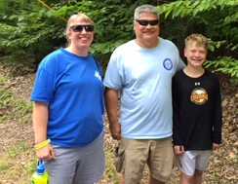
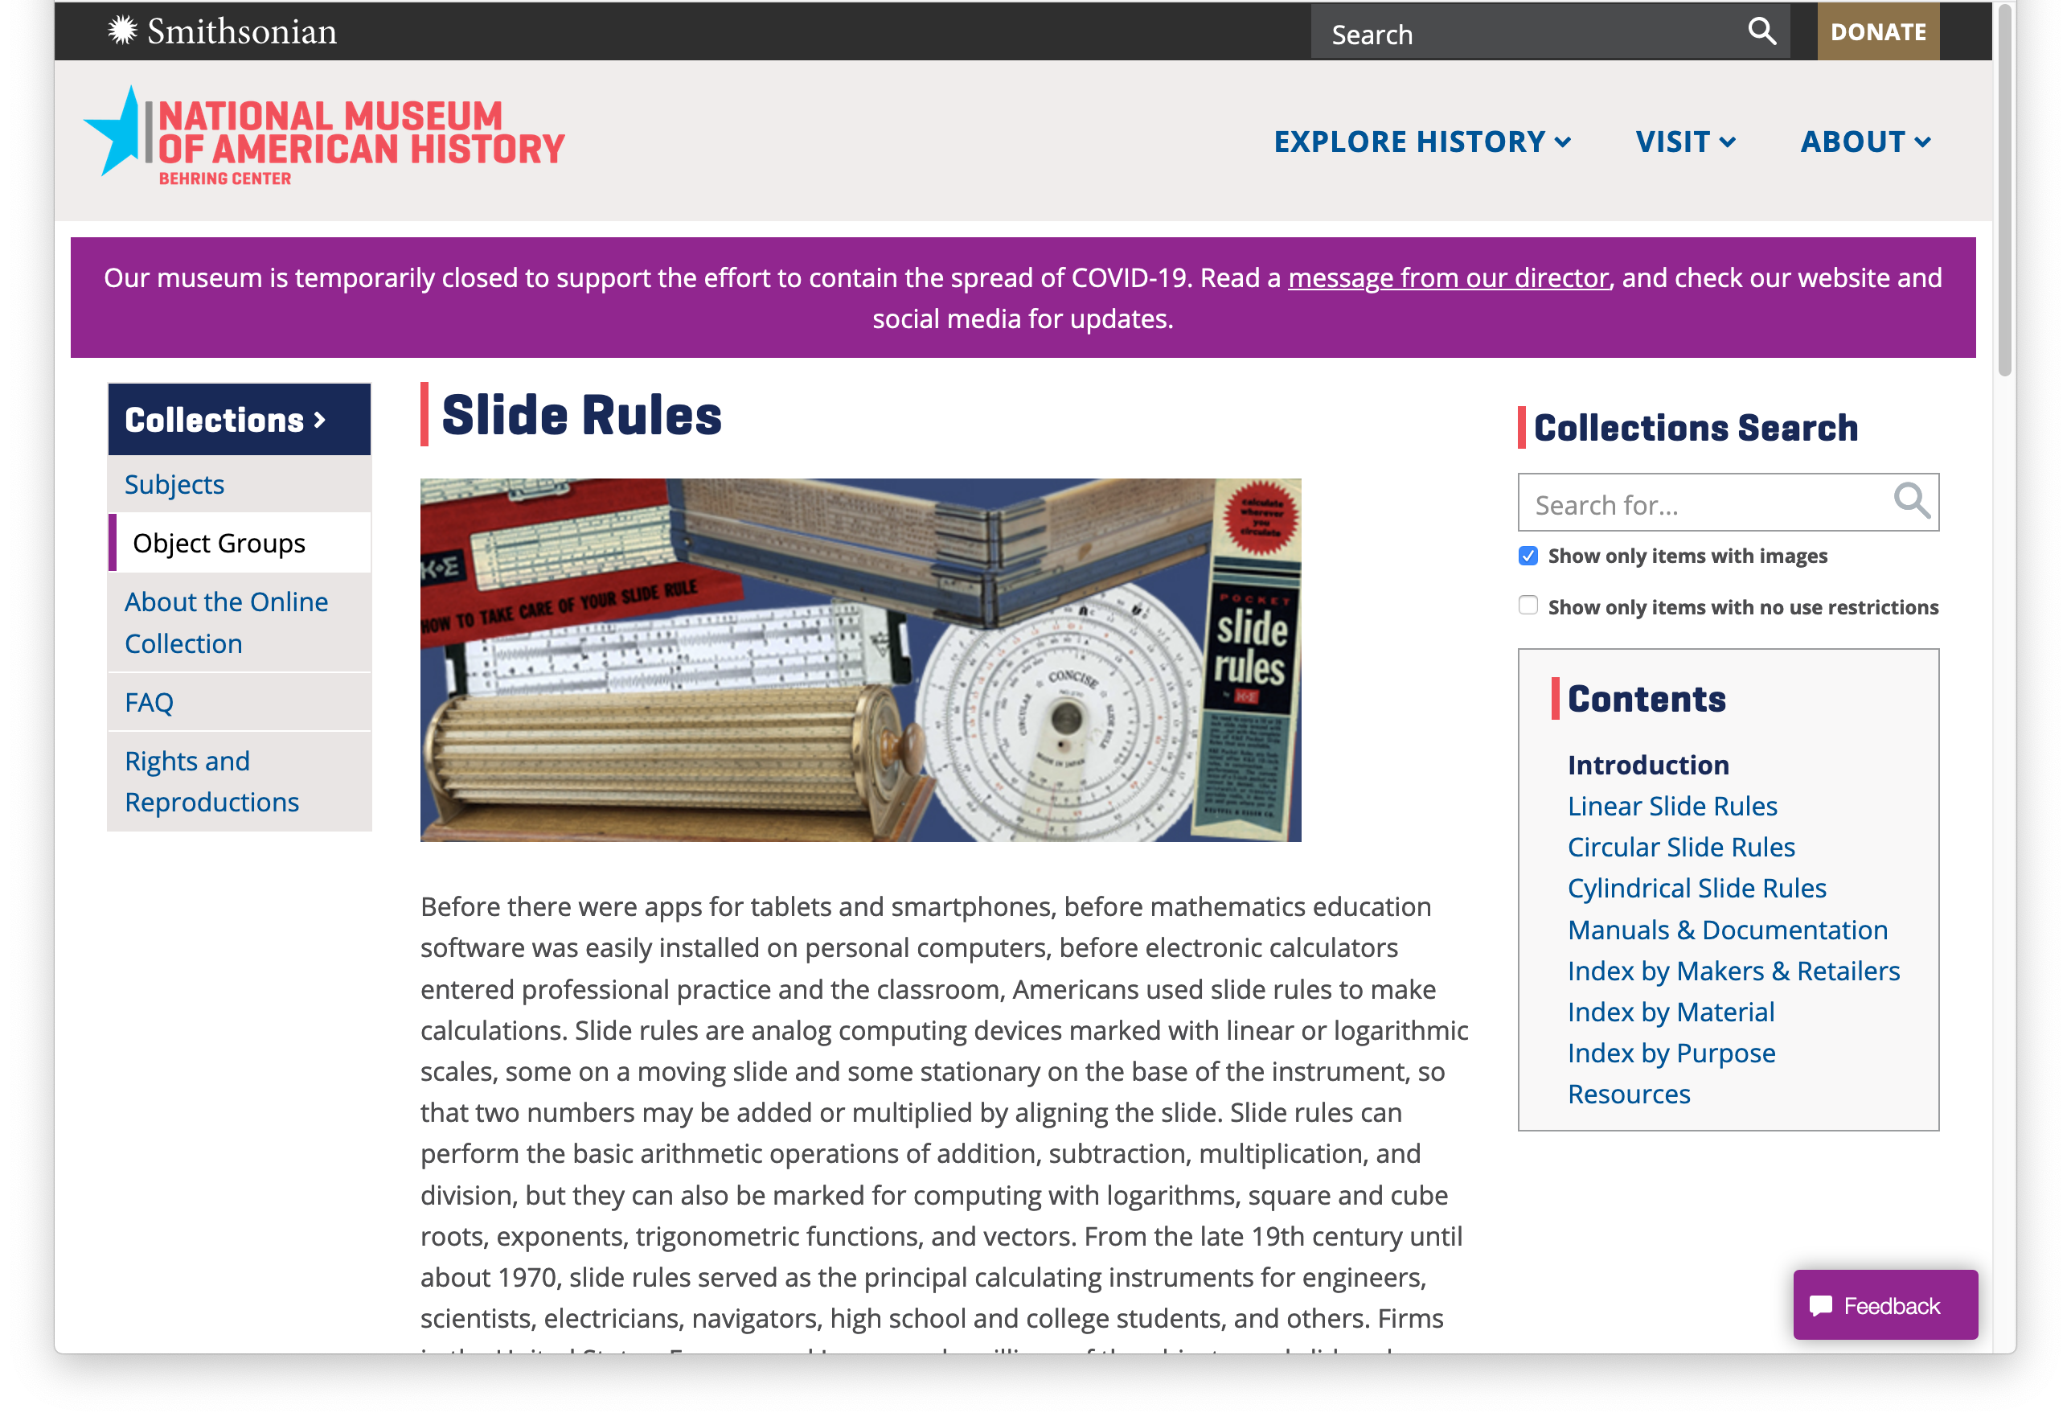
Amy Ackerberg-Hastings
Two Shameless Promotions
National Museum of American History, Smithsonian Institution
Slide Rule Object Group:
https://americanhistory.si.edu/collections/object-groups/slide-rules
Mathematical Association of America Convergence
https://www.maa.org/press/periodicals/convergence/about-convergence
Invites articles on using history of slide rules to teach mathematics

Slide 3
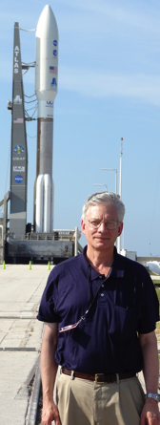
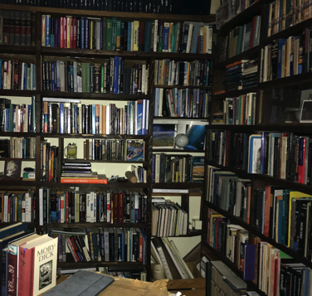
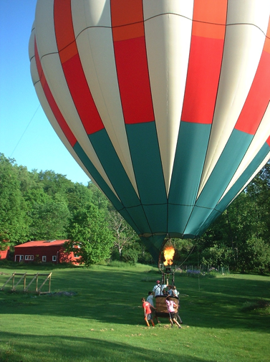
Michael Allison
Salem, NY – USA
Retired NASA scientist – formerly at the
Goddard Institute for Space Studies in New York City.
Worked in planetary atmospheres – on the science teams for the Cassini / Huygens mission to Saturn and Titan, also the Juno Jupiter orbiter.
Currently Adjunct Professor of Astronomy – Columbia University.
Live with my wife on a 10 acre (4 hectare) farm place in rural upstate NY, building a research library within a 19th century barn.
Have taught an informal class on the slide rule, attended by the town calculus teacher, the president of the local astronomy club, a balloon pilot, and a mathematical artist.

Slide 4
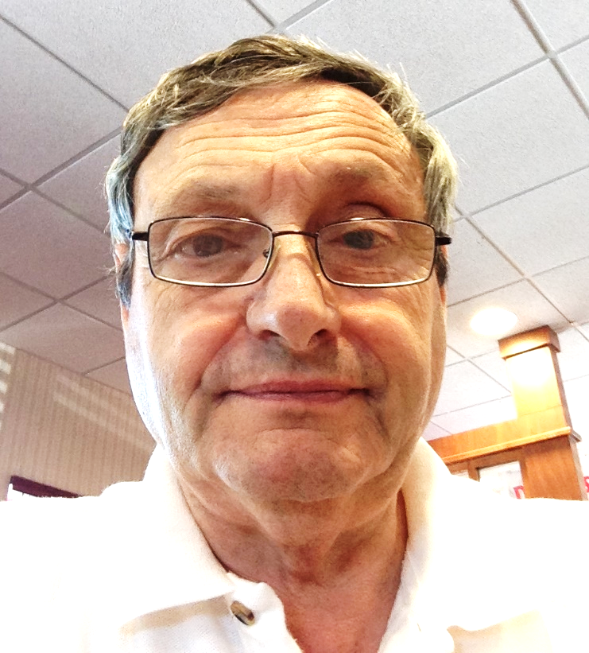
George W. Anderson Baltimore, MD
Engineer, Systems, Aero & Mechanical
USAF Pilot
NTSB Aircraft Accident Investigator
Slide rule user in college
Slide rule collector focused on education, preservation and use.
Interests
Slide rule history
Slide rule provenance
Related applications such as nomography

Slide 5
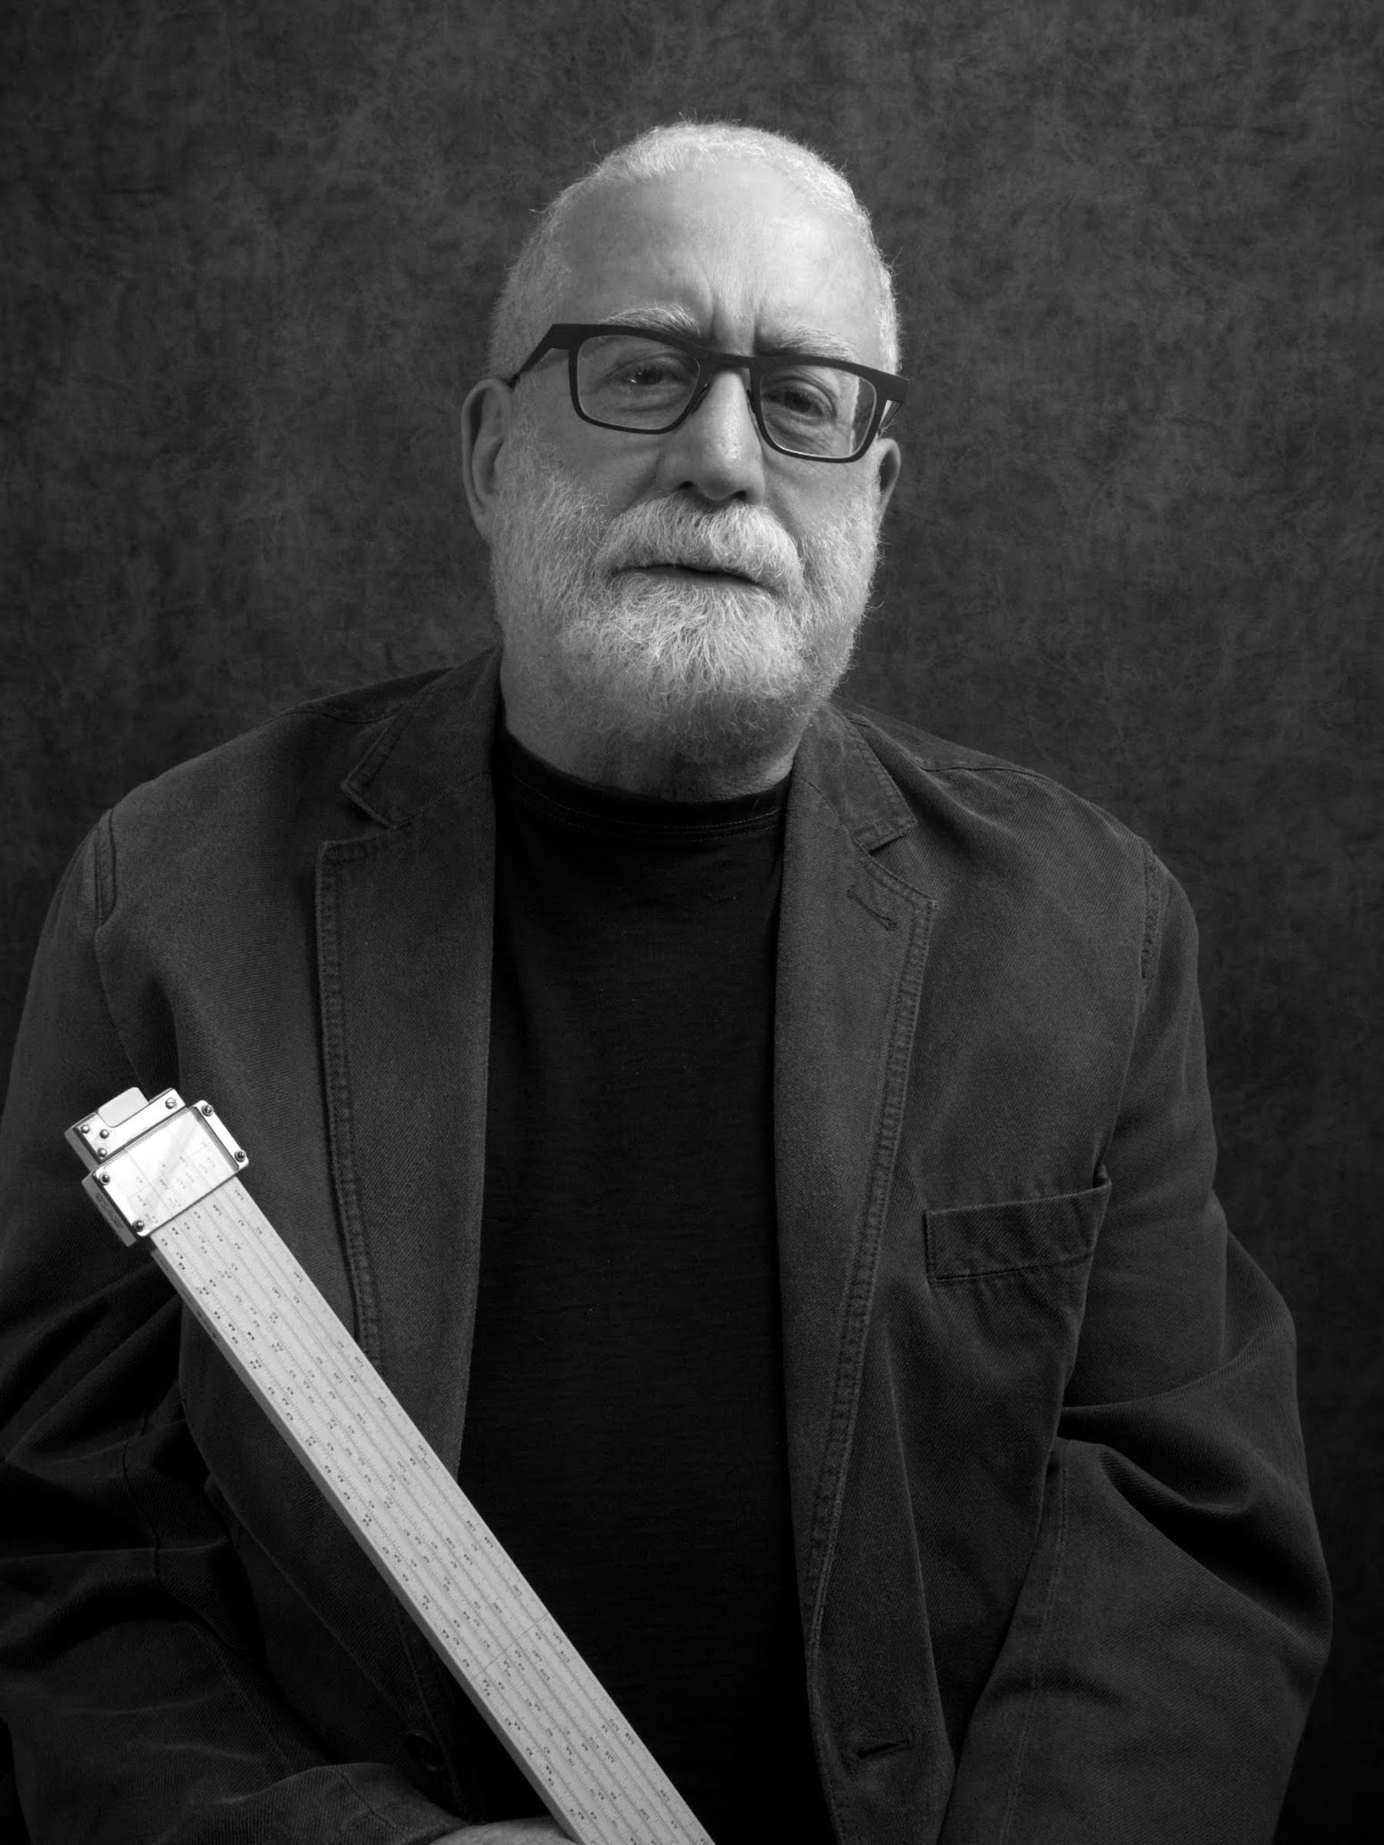
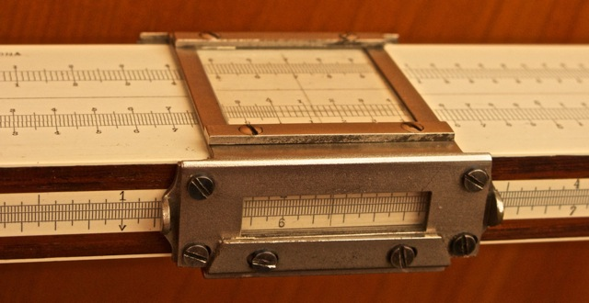
Fred Astren
Semi-retired university professor
San Francisco Bay Area
In 2003, while on a six-month sabbatical in England, I began collecting boxwood and brass folding rules. From there, it was a natural progression to the joint slide rules that Peter Hopp wrote about to full-blown slide rule collecting. I bought my first slide rule in July 2011 and never looked back. My main interests:
• Late 19th and early 20th-century rules, especially
Nestler, Faber-Castell, and Tavernier-Gravet
• Boxwood rules for gauging and other specialties
MY DENNERT & PAPE NO. 29 SYSTEM NELTING
I am fascinated by the makers, original sellers, and former owners whose names are marked on slide rules and cases. These identifications open up windows into the history of industry, commerce, and technology. Sometimes, they add a human face to what are otherwise mute artifacts from the past.

Slide 6
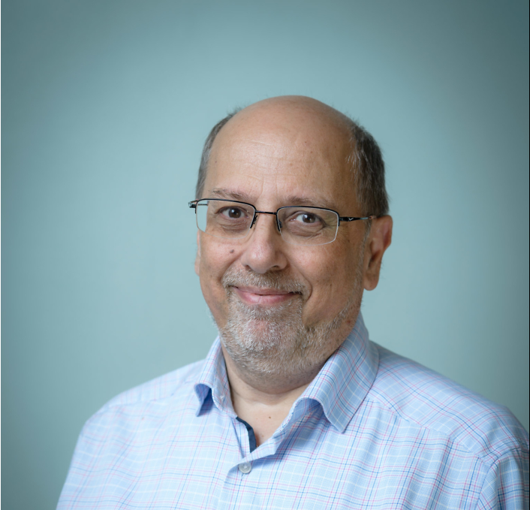
Francesco Basta
Italian, born in Perugia in 1954
Living in Utrecht, the Netherlands
Member of the Kring Historische Rekeninstrumenten (Dutch club of collectors)
MS in Electronics Engineering, University of Pisa 1985
Started collecting slide rules in 1998; radioamateur since 1974 (call signs: I0VFB, HB9TWZ, PE1F)
Modest collection of about 80 rules
Main field of interest: what could we do with slide rules in the XXI century ?

Slide 7
Jim Bready
Editor, Journal of the Oughtred Society
Slide Rule Interests:
‘Landmark’ slide rules – models that introduced new ideas or features
Any slide rule that shows clever design or ‘out of the box’ thinking
Anything beautiful
Anything with a good story

Slide 9
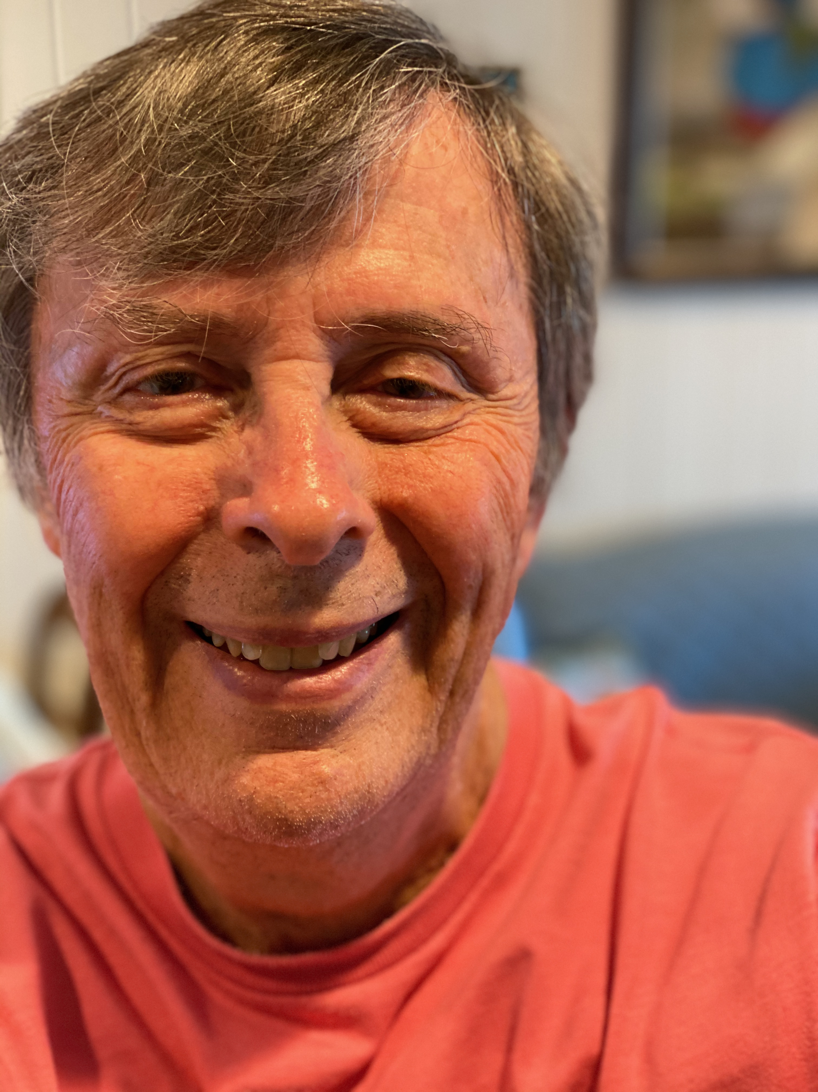
Joseph “Bibb” Cain
Electrical Engineering background
Used Slide rules in college and work
Started collecting about 6+ years ago
Have acquired a number of vintage AW Faber rules (100 years old or more)
Interested in specialized rules for areas such as Electronics, Chemistry, and Space especially the Martin Space Rule
Recently took an Orbital Mechanics course

Slide 10
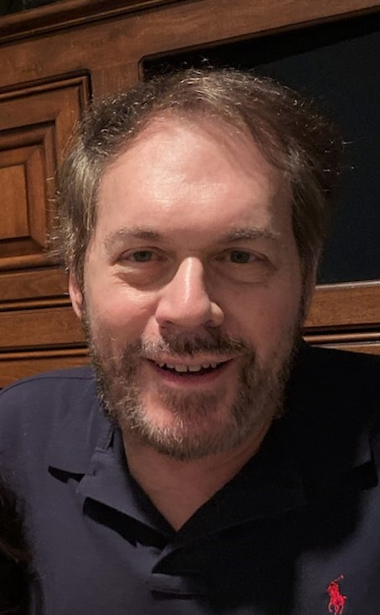
Bob De Cesaris
Granite Bay, CA
Mathematics, physics, electrical engineering, computer science
Three years at MICARL, Tempe AZ (Motorola Integrated Research Labs)
Thirty-four years at Intel Corp, Folsom, CA, engineering and management
Director, Product Development and Manufacturing, Chipsets and SOC IP Group
Honor of Serving as Oughtred Society president since 2007
Collect: Early or Unusual Slide Rules, Mechanical Calculators, Early Math and Science Books, 15th–19th Century Maps……

Slide 11
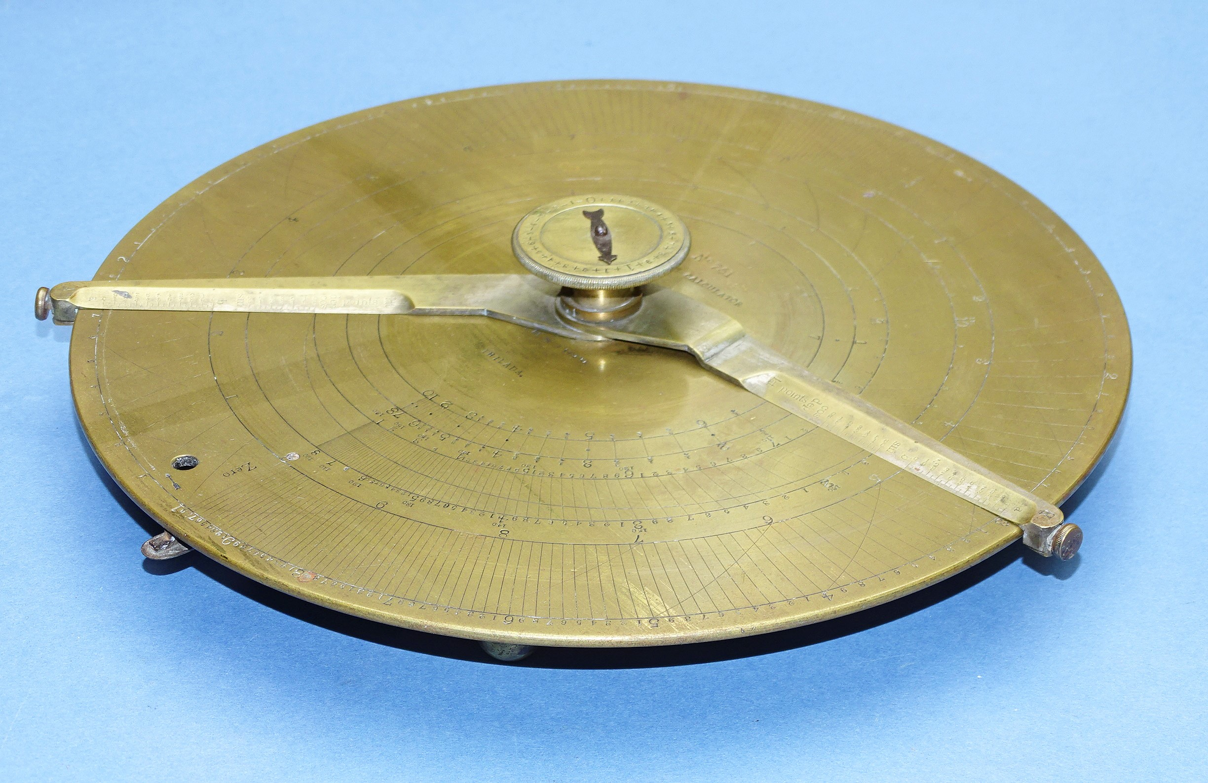
Bob De Cesaris
Granite Bay, CA
Mathematics, physics, electrical engineering, computer science
Three years at MICARL, Tempe AZ (Motorola Integrated Research Labs)
Thirty-three years at Intel Corp, Folsom, CA, engineering and management
Director, Product Development and Manufacturing, Chipsets and SOC IP Group
Collect: Early or Unusual Slide Rules, Mechanical Calculators, Early Math and Science Books, 15th–19th Century Maps,

Slide 12
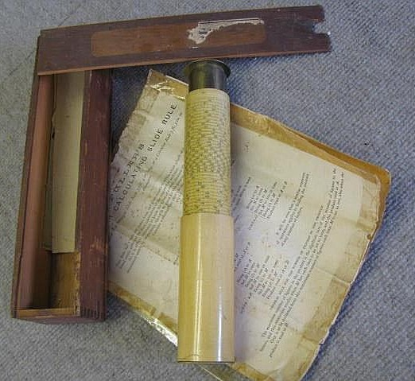
Bob De Cesaris
Granite Bay, CA
Mathematics, physics, electrical engineering, computer science
Three years at MICARL,Tempe AZ (Motorola Integrated Research Labs)
Thirty-three years at Intel Corp, Folsom, CA, engineering and management
Director, Product Development and Manufacturing, Chipsets and SOC IP Group
Collect: Early or Unusual Slide Rules, Mechanical Calculators, Early Math and Science Books, 15th–19th Century Maps,

Slide 13
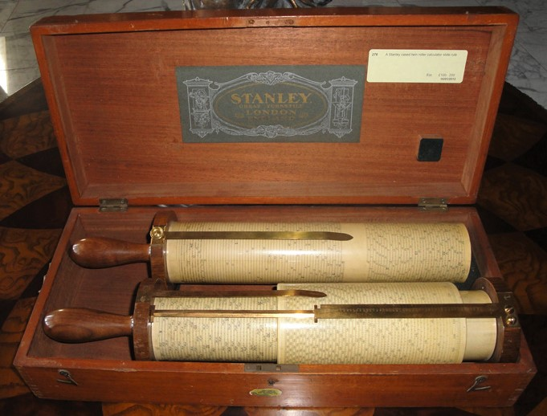
Bob De Cesaris
Granite Bay, CA
Mathematics, physics, electrical engineering, computer science
Three years at MICARL, Tempe AZ (Motorola Integrated Research Labs)
Thirty-three years at Intel Corp, Folsom, CA, engineering and management
Director, Product Development and Manufacturing, Chipsets and SOC IP Group
Collect: Early or Unusual Slide Rules, Mechanical Calculators, Early Math and Science Books, 15th–19th Century Maps,

Slide 14
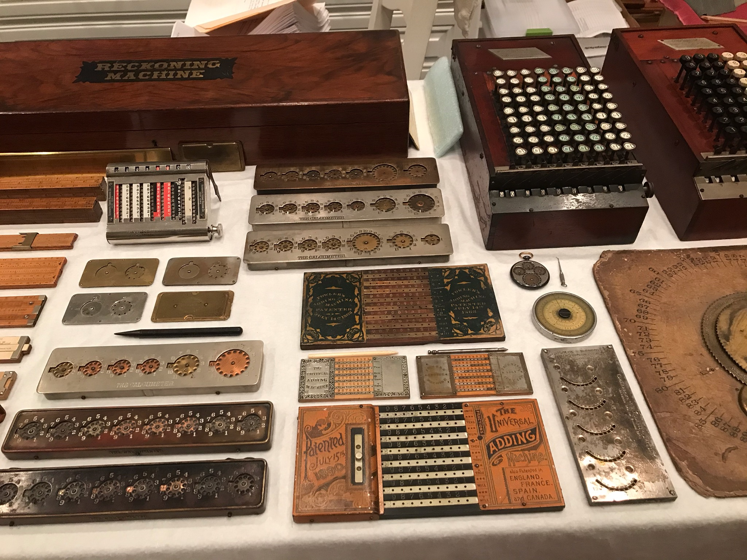
Bob De Cesaris
Granite Bay, CA
Mathematics, physics, electrical engineering, computer science
Three years at MICARL,Tempe AZ (Motorola Integrated Research Labs)
Thirty-three years at Intel Corp, Folsom, CA, engineering and management
Director, Product Development and Manufacturing, Chipsets and SOC IP Group
Collect: Early or Unusual Slide Rules, Mechanical Calculators, Early Math and Science Books, 15th–19th Century Maps,

Slide 15
Bob De Cesaris
Granite Bay, CA
Mathematics, physics, electrical engineering, computer science
Three years at MICARL,Tempe AZ (Motorola Integrated Research Labs)
Thirty-three years at Intel Corp, Folsom, CA, engineering and management
Director, Product Development and Manufacturing, Chipsets and SOC IP Group
Collect: Early or Unusual Slide Rules, Mechanical Calculators, Early Math and Science Books, 15th–19th Century Maps,

Slide 16
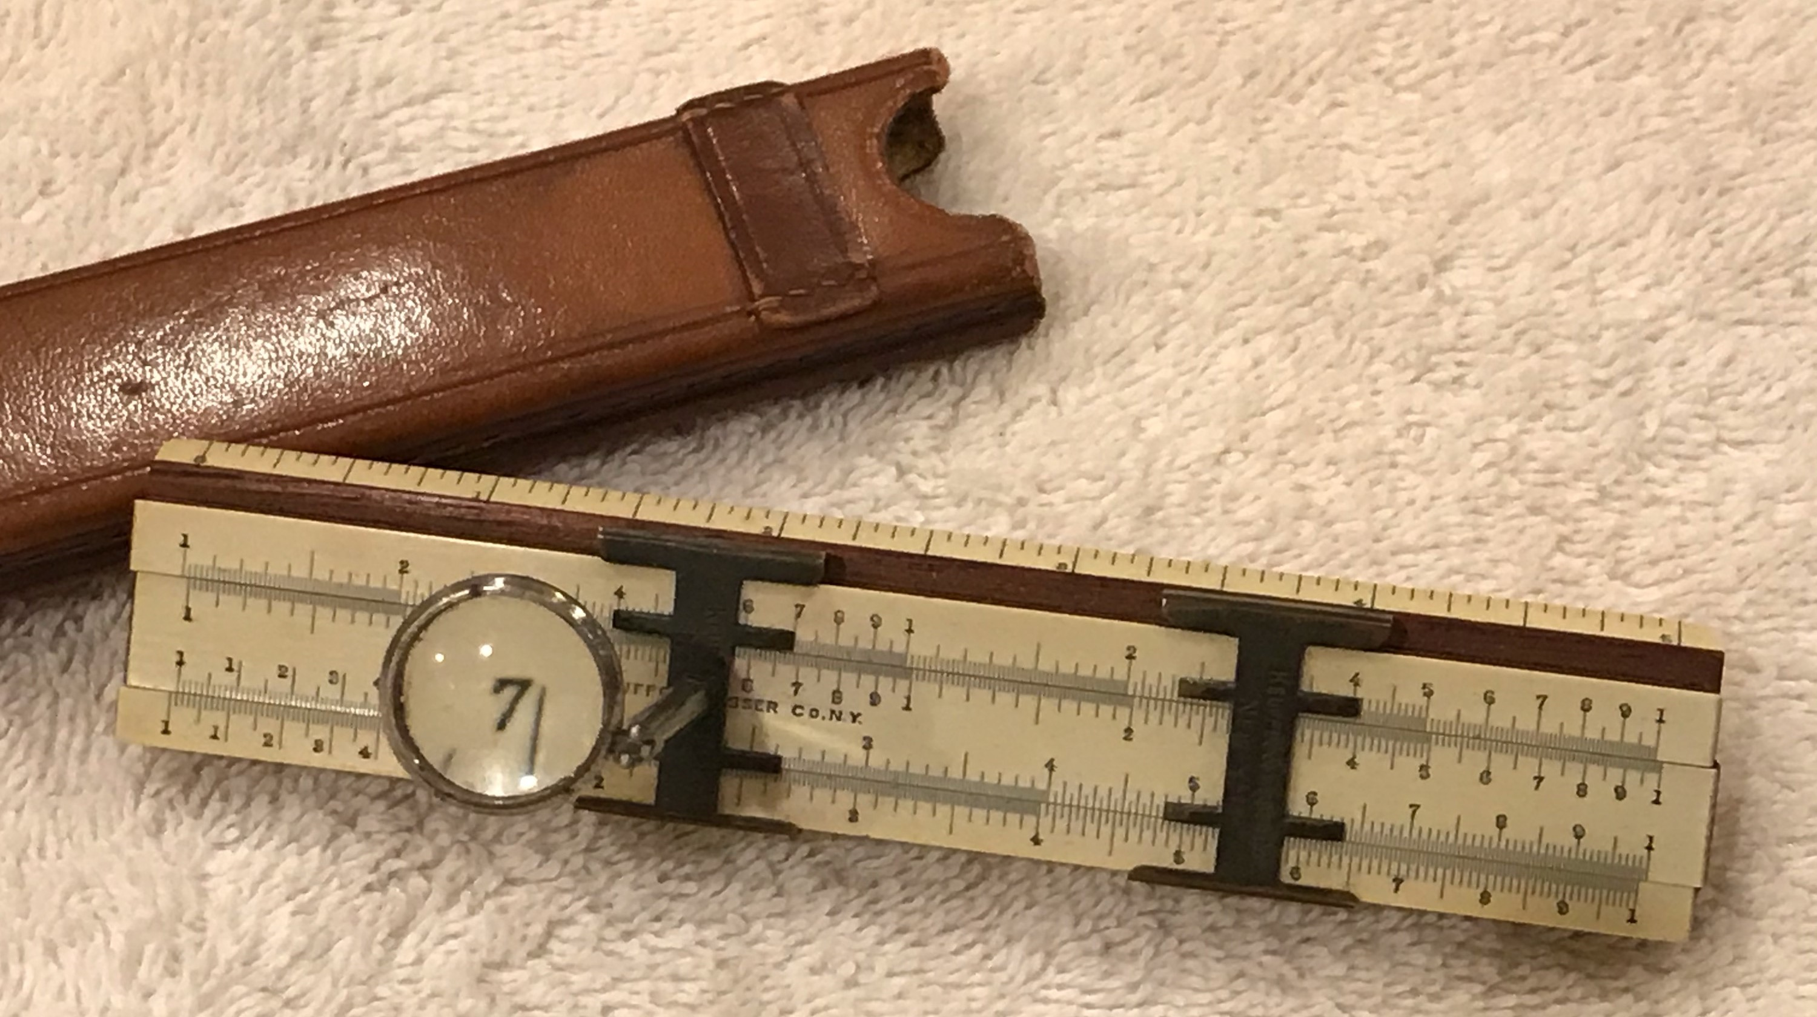
Bob De Cesaris
Granite Bay, CA
Mathematics, physics, electrical engineering, computer science
Three years at MICARL,Tempe AZ (Motorola Integrated Research Labs)
Thirty-three years at Intel Corp, Folsom, CA, engineering and management
Director, Product Development and Manufacturing, Chipsets and SOC IP Group
Collect: Early or Unusual Slide Rules, Mechanical Calculators, Early Math and Science Books, 15th–19th Century Maps,

Slide 17
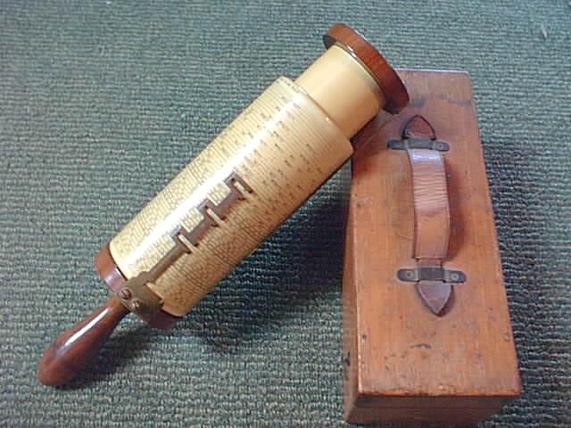
Bob De Cesaris
Granite Bay, CA
Mathematics, physics, electrical engineering, computer science
Three years at MICARL,Tempe AZ (Motorola Integrated Research Labs)
Thirty-three years at Intel Corp, Folsom, CA, engineering and management
Director, Product Development and Manufacturing, Chipsets and SOC IP Group
Collect: Early or Unusual Slide Rules, Mechanical Calculators, Early Math and Science Books, 15th–19th Century Maps,

Slide 18
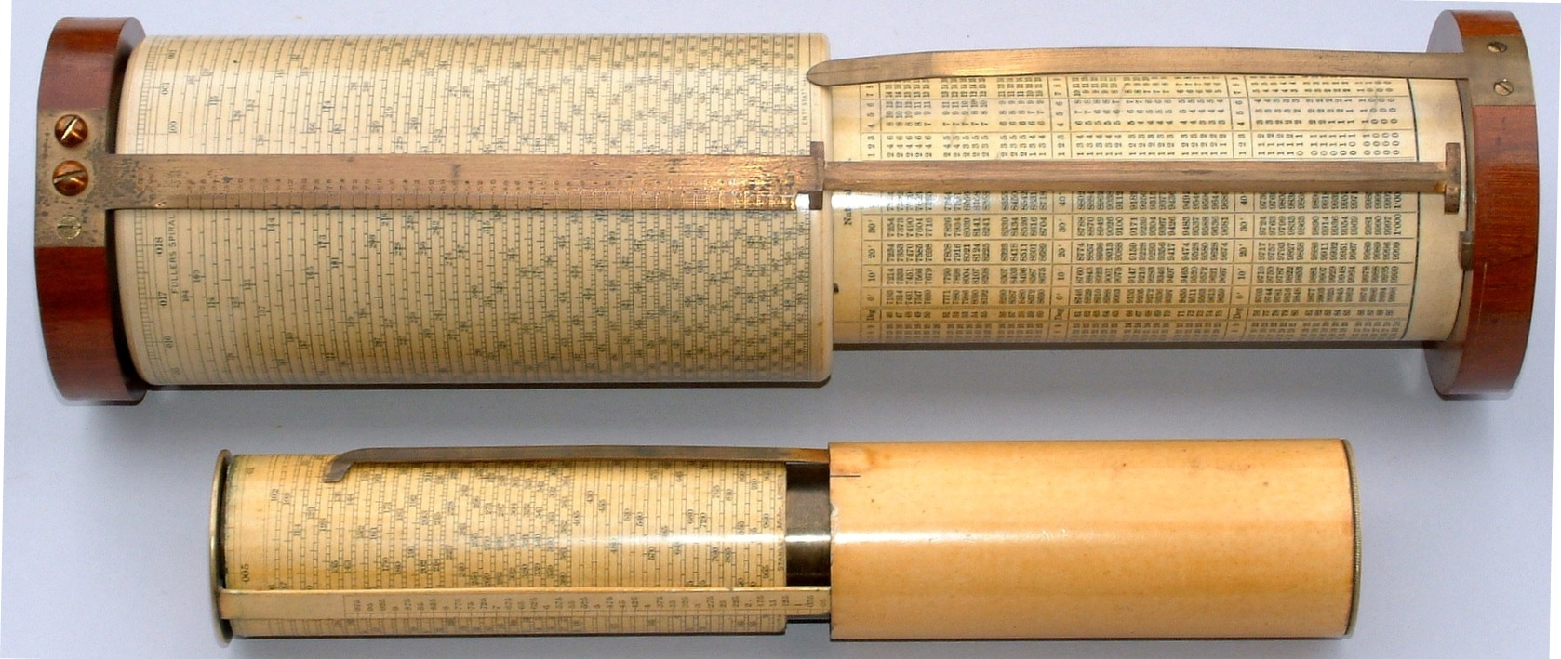
Bob De Cesaris
Granite Bay, CA
Mathematics, physics, electrical engineering, computer science
Three years at MICARL,Tempe AZ (Motorola Integrated Research Labs)
Thirty-three years at Intel Corp, Folsom, CA, engineering and management
Director, Product Development and Manufacturing, Chipsets and SOC IP Group
Collect: Early or Unusual Slide Rules, Mechanical Calculators, Early Math and Science Books, 15th–19th Century Maps,

Slide 19
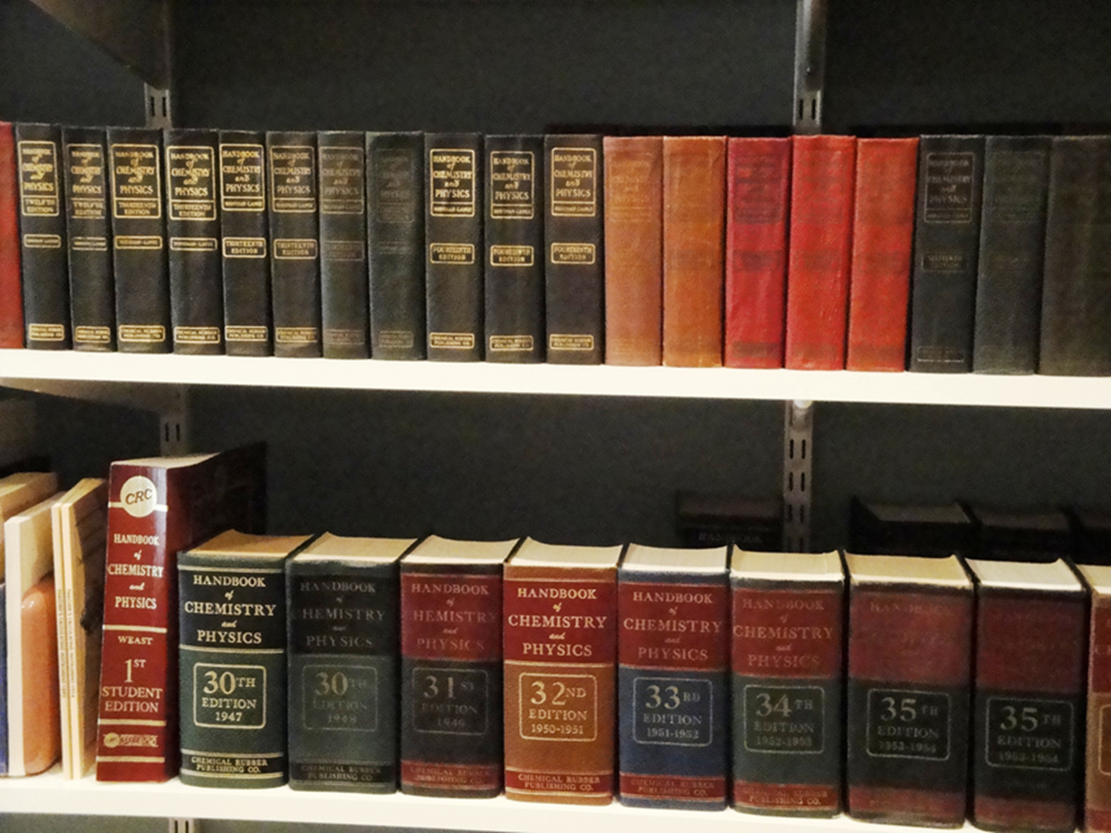
Bob De Cesaris
Granite Bay, CA
Mathematics, physics, electrical engineering, computer science
Three years at MICARL,Tempe AZ (Motorola Integrated Research Labs)
Thirty-three years at Intel Corp, Folsom, CA, engineering and management
Director, Product Development and Manufacturing, Chipsets and SOC IP Group
Collect: Early or Unusual Slide Rules, Mechanical Calculators, Early Math and Science Books, 15th–19th Century Maps,

Slide 20
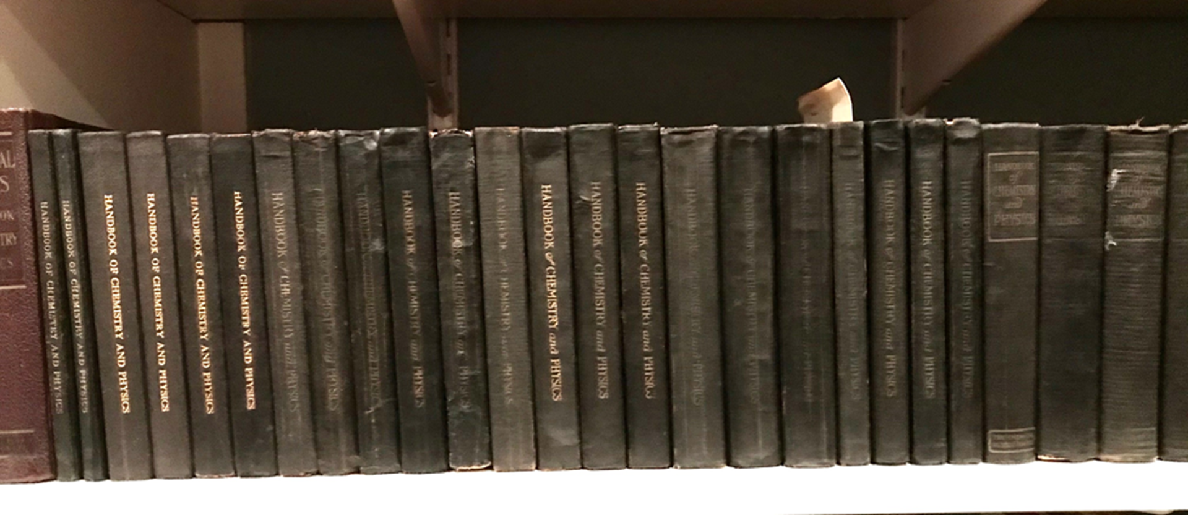
Bob De Cesaris
Granite Bay, CA
Mathematics, physics, electrical engineering, computer science
Three years at MICARL,Tempe AZ (Motorola Integrated Research Labs)
Thirty-three years at Intel Corp, Folsom, CA, engineering and management
Director, Product Development and Manufacturing, Chipsets and SOC IP Group
Collect: Early or Unusual Slide Rules, Mechanical Calculators, Early Math and Science Books, 15th–19th Century Maps,

Slide 21
Bob De Cesaris
Granite Bay, CA
Mathematics, physics, electrical engineering, computer science
Three years at MICARL, Tempe AZ (Motorola Integrated Research Labs)
Thirty-four years at Intel Corp, Folsom, CA, engineering and management
Director, Product Development and Manufacturing, Chipsets and SOC IP Group
Honor of Serving as Oughtred Society president since 2007
Collect: Early or Unusual Slide Rules, Mechanical Calculators, Early Math and Science Books, 15th–19th Century Maps……

Slide 22
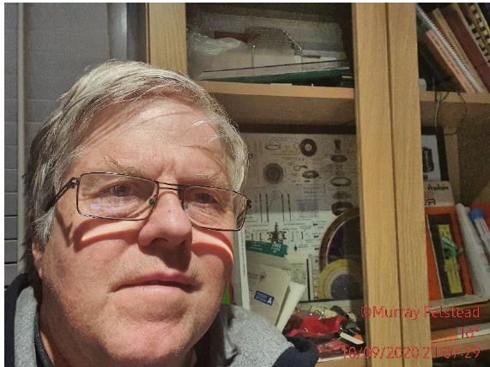
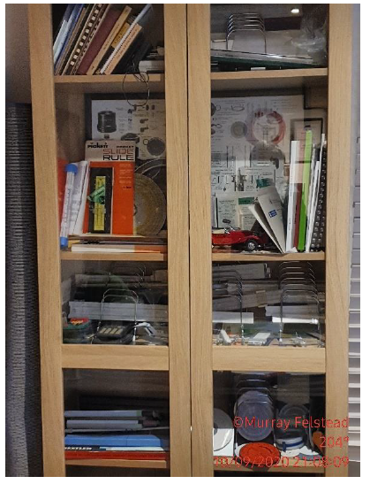
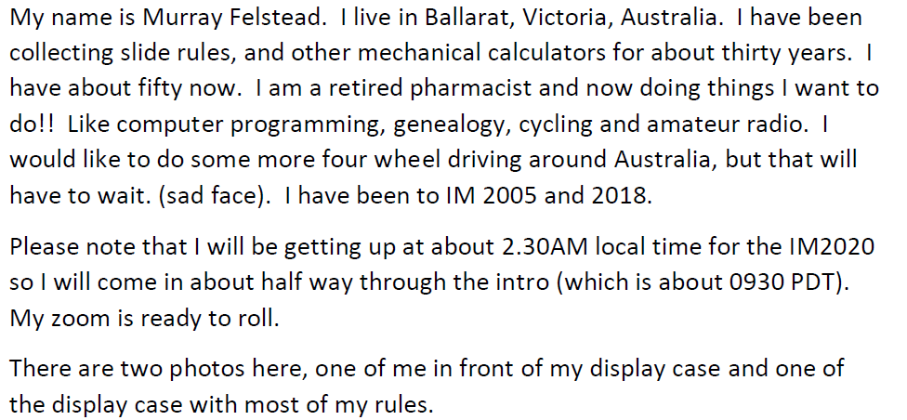
Murray Felstead

Slide 23
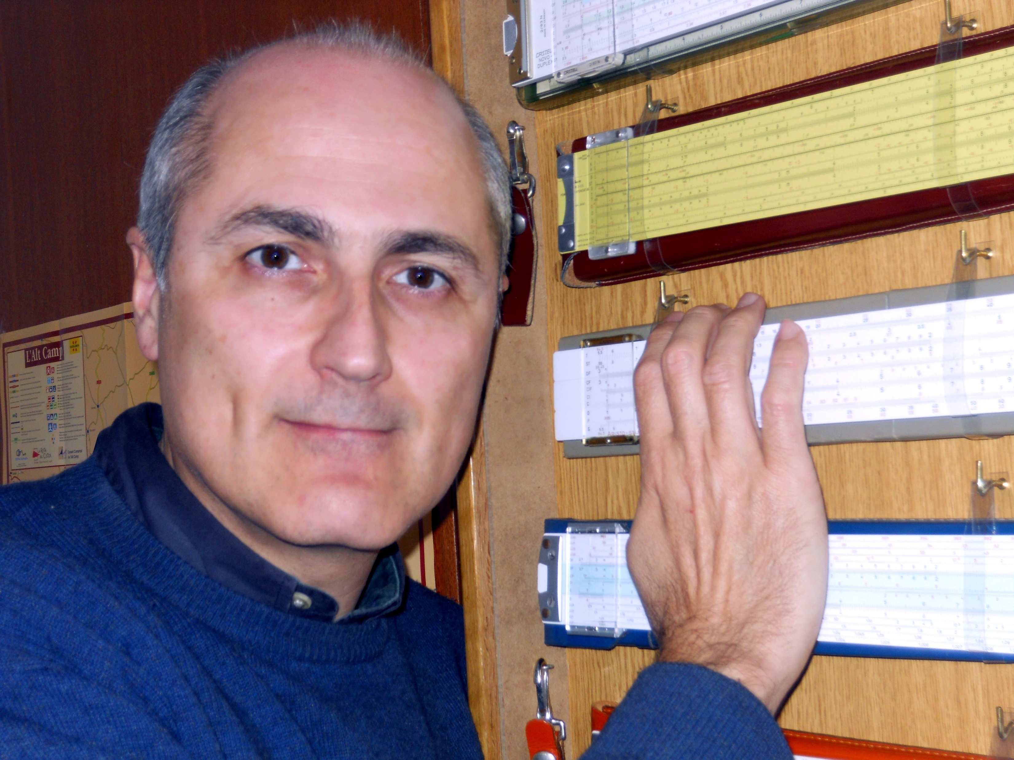
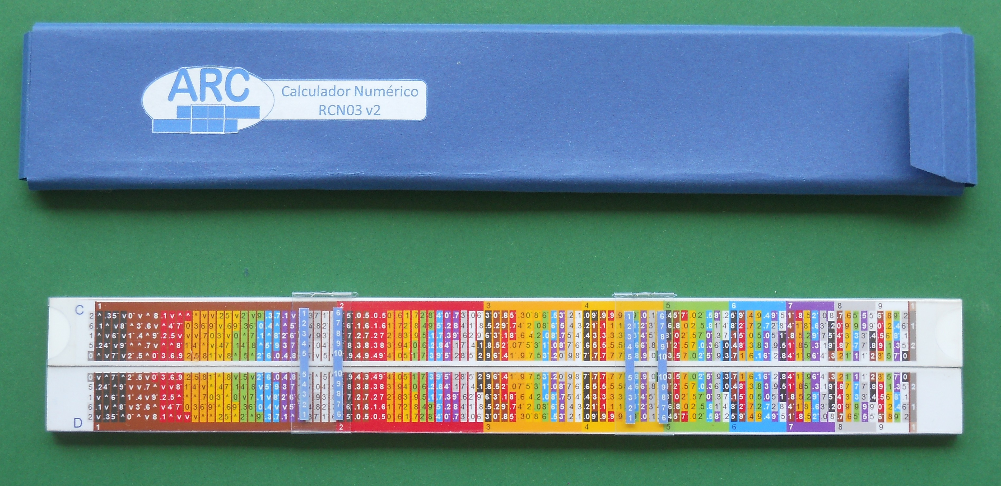
Jose Gabriel Fernández
My interests in slide rules
Collecting what I like
Study models and understand the purposes behind
Increase knowledge e-database in Spanish
Search, prototype and evolve forgotten designs
Learn, collaborate, communicate
Enjoy the slide rule world!
1990 – Electronics Engineer
1987 – I bought my first slide rule in a Flea market
2007 – Discovered e-Bay sold slide rules
2008 – Joined Spanish Association ARC
2009 – First IM presentation
2016 – OS Fellowship

Slide 24
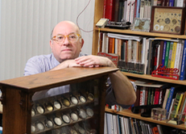
Tom Frank
Hello All:
I am Tom Frank, located in Rhode Island (US).
I’ve been with the OS since the beginning, and I would like to thank everyone for the tireless effort that has made the organization what it is.
With retirement only a few more years away, I look forward to the opportunity to being of service.
While I have an eclectic collection (which is to admit it is unfocused), my primary
interest has been projection slide rules (the sort that would have been used in educational settings), and some specialized rules. I still use a Pickett at work.
Other interests are clocks and watches, photography, and amateur radio (KA2CDK).
Looking forward to seeing you all, and the interesting presentations!

Slide 25
Cliff Frohlich
with slide rule cabinet, built in my garage;
long gourd, grown in my garden and painted;
and MathMaster slide rule.
[Cliff@ig.utexas.edu]
Formerly I was a researcher at the University of
Texas at Austin, but I am now retired.
Interests:
• Specialized, unusual, colorful, or well-made
slide rules: ”I know it when I see it”
• “Many are Hemmi”
• Question: Hemmi baseball rule—Paul Ross says:
’probably a promotional item’, but…
What team? What game(s)?’

Slide 26
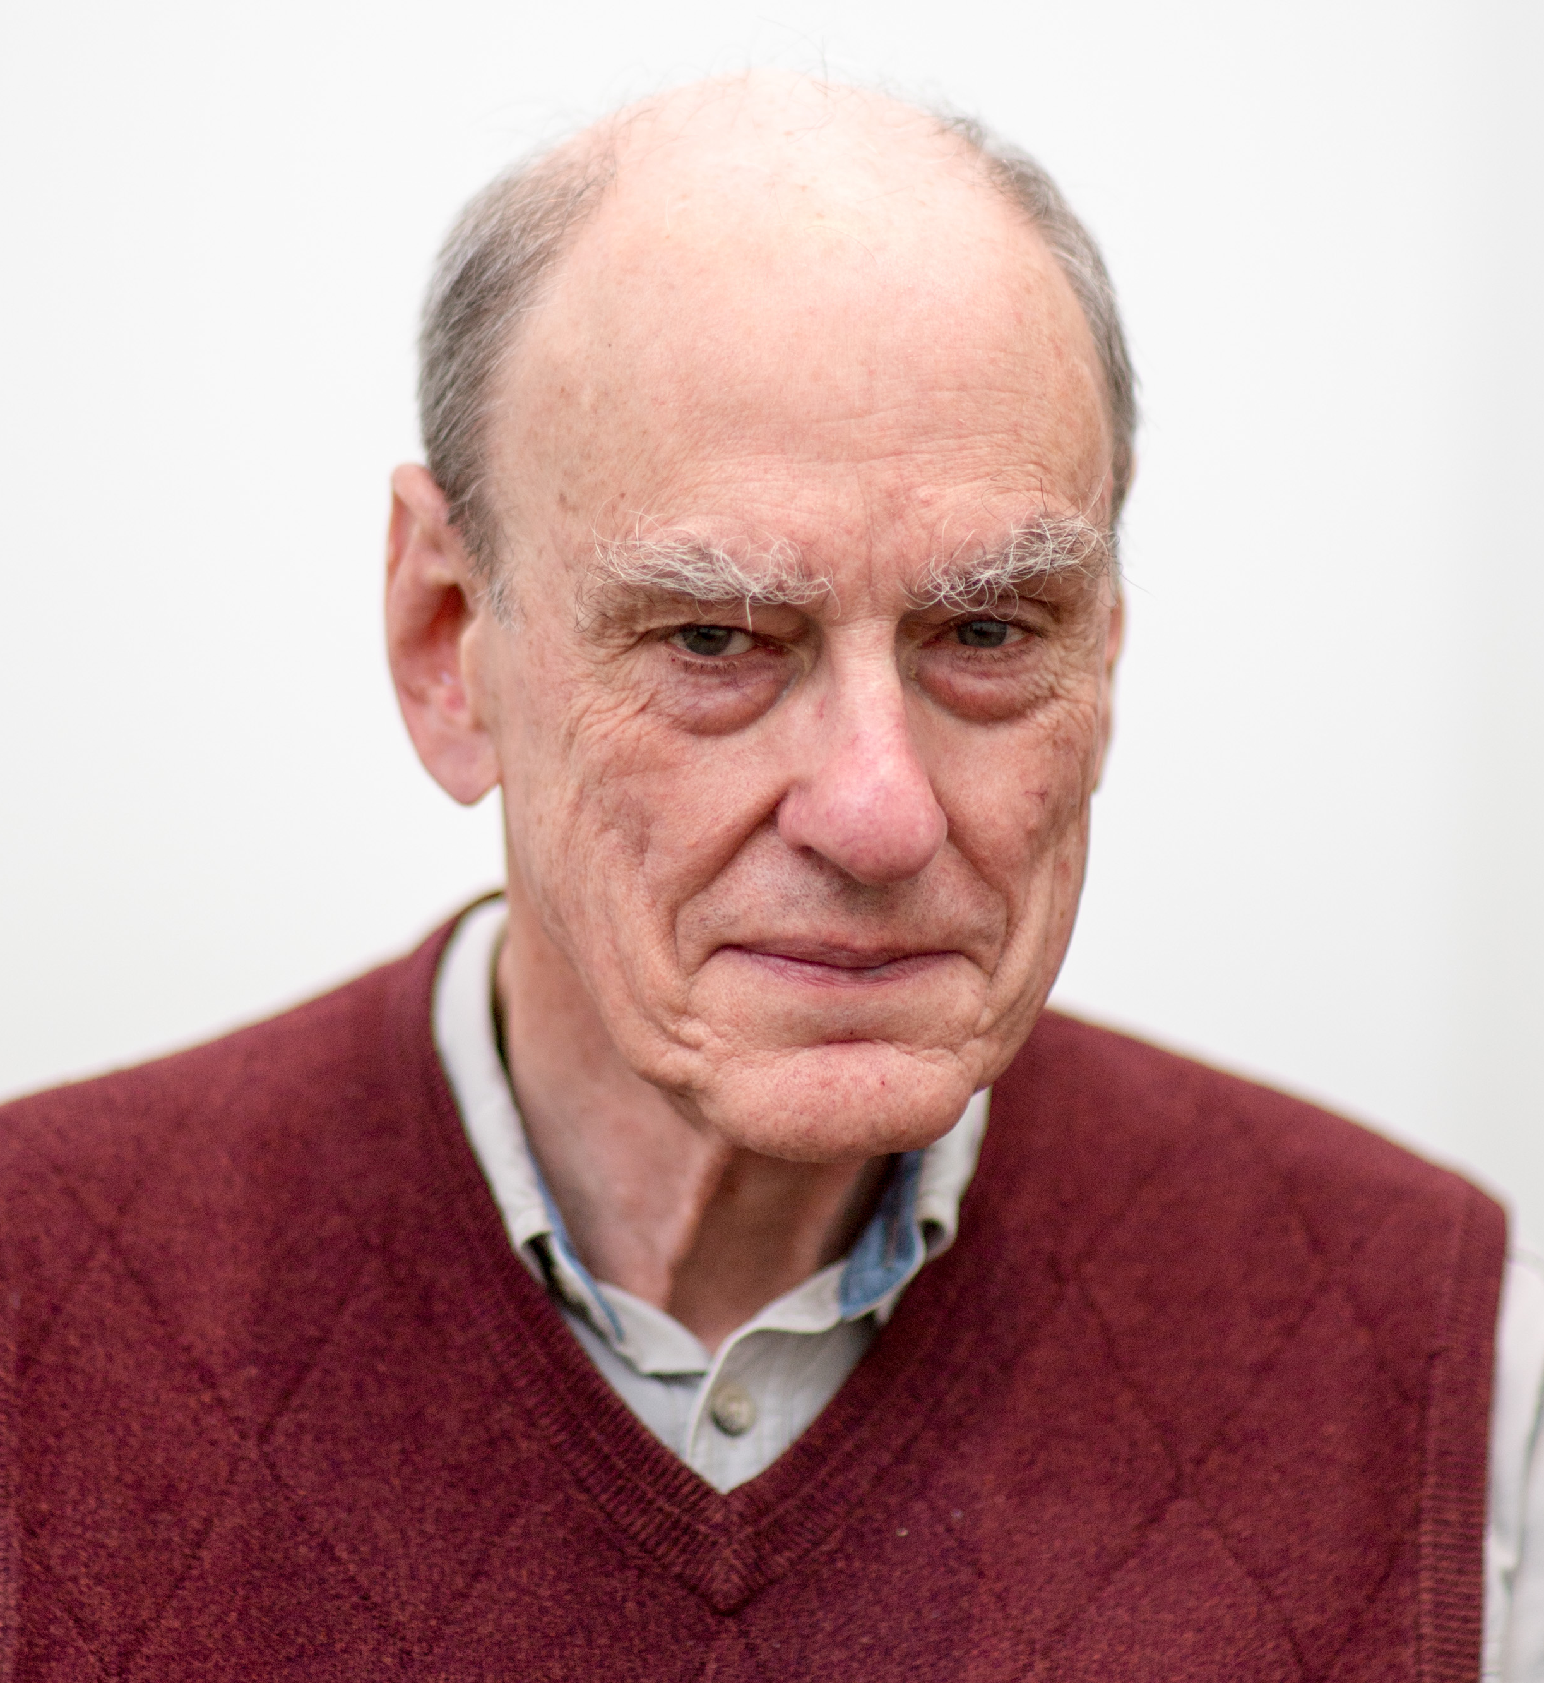
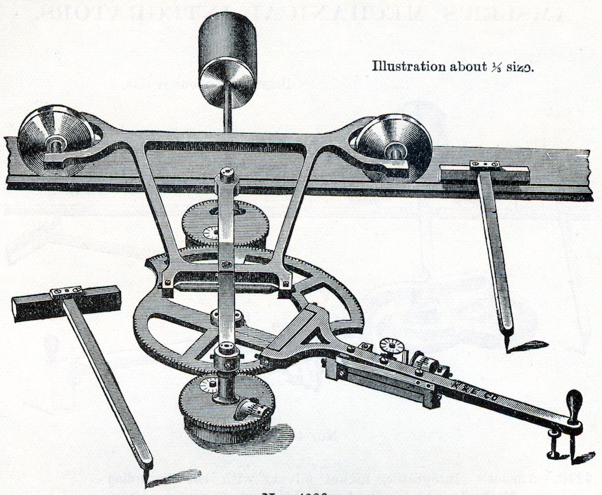
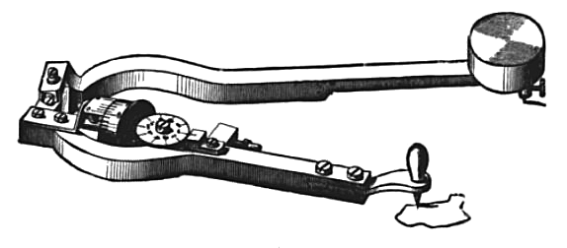
Harold Frost Materials Science, Mechanics, and Thermodynamics. Dartmouth College, Thayer School of Engineering, since 1981.
Primary Collection:
Planimeters and Integrators.
Current Interest:
Developing a course on the History of Pre-electronic Computing.
• To teach engineering students a little history.
• To teach non-technical students an appreciation of numeracy.
https://drive.google.com/file/d/1jYYNWsm1qIHO_tA66lUlGaHymvz_VK8R/view?usp=sharing
Thayer School of Engineering, Dartmouth College
14 Engineering Drive, Hanover, New Hampshire 03755
harold.j.frost@dartmouth.edu

Slide 27
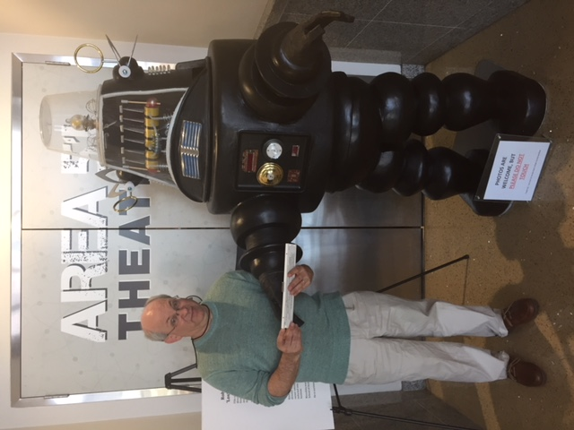
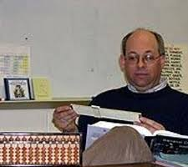
Louis J. Gotlib
20+ year OS member
Main interest is chemical and
chemistry related slide rules
Collection of over 1700 items
(my wife is thrilled!)

Slide 28
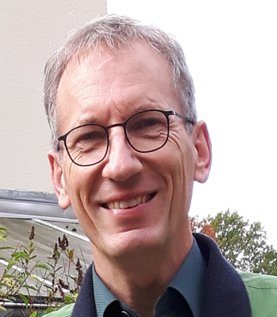
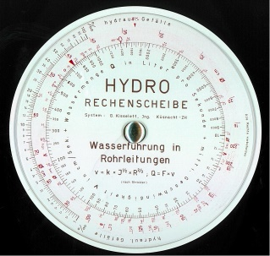
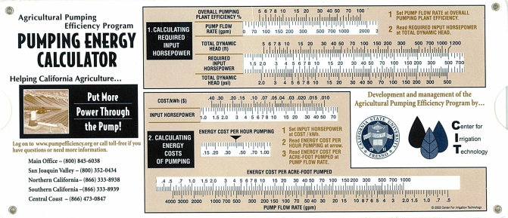
Stefan Heimann, Berlin, DE
Professor for Hydraulic Engineering (for Civil and Environmental Engineers)
Slide Rules for Hydraulic Engineers
https://prof.beuth-hochschule.de/heimann/rechenschieber-fuer-das-bauwesen/wasserbau-hydraulic-engineering/?print=1
Hydrology: Run Off
Weirs & Notches
Pipes for Water Supply & Irrigation
Sewers & Culverts
Pumps & Turbines
Open Channels: Rivers & Canals

Slide 29
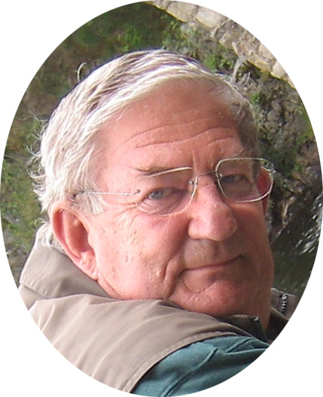
Peter Hopp
C.Eng. MBCS
Retired Computer Systems Engineer.
Researcher and Author of things slide rule and technical
3 / 4 books published
Collector of slide rules
Long term OS Member
Founder Member UKSRC

Slide 30
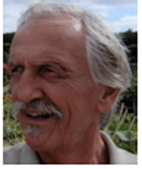
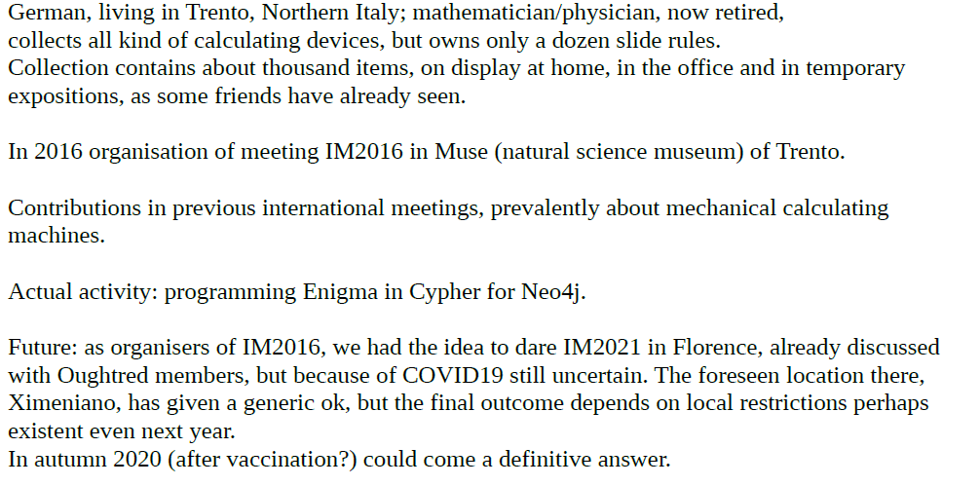
Dr. Wolfgang J. Irler
Trento, Italy

Slide 31
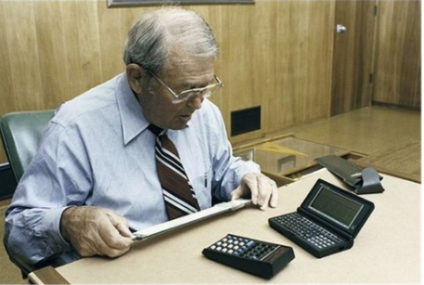
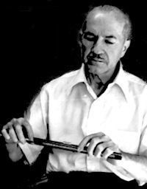
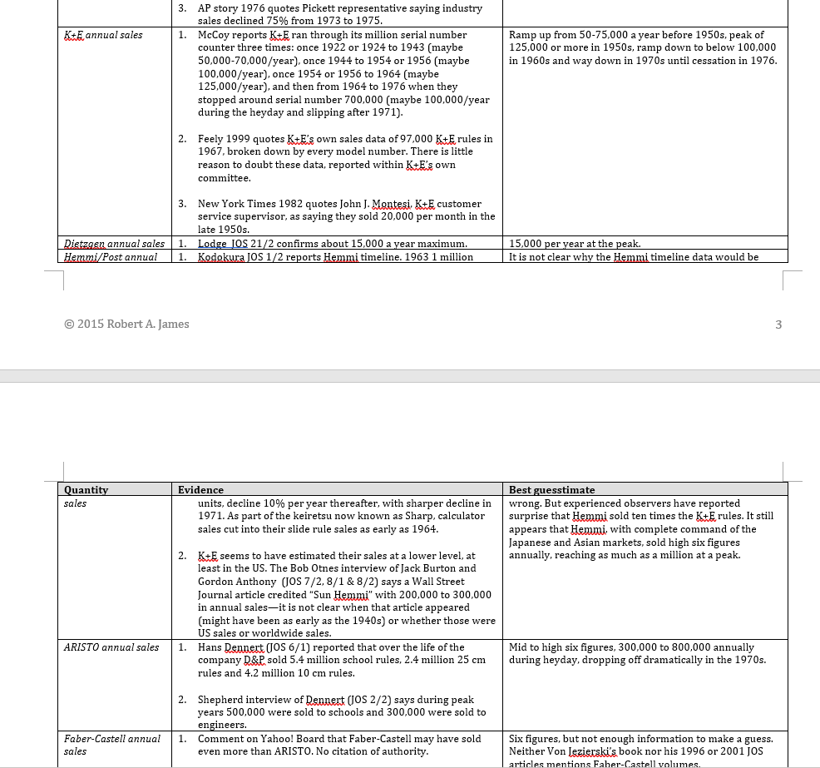
Rob James
Piedmont, California

Slide 32
Curtis Jones, San José, California
Around age 11 (1953) I ordered a slide rule for $0.50 from Engineering Instruments, Peru, Indiana through Boys Life. My uncle the physics professor explained logarithms and how to multiply numbers by adding logs. I’m sure he showed me how this is done on a slide rule. More practical: A babysitter showed how to put the index over one number, move the slider to the other number and read the product underneath.
A chemistry class in college began with teaching the slide rule. I was tired of running off the end of my straight slide rules and bought a circular slide rule. Post/Gilson circular slide rules were in my pocket till HP-11: RPN & small enough to fit my pocket. That was in 1982.
It was a few years later that my wife decreed I was a slide-rule collector.
Notes:
1974: Major professor ran out of money and got a former student to hire me at IBM in San Jose. That’s where I started to use APL.

Slide 33
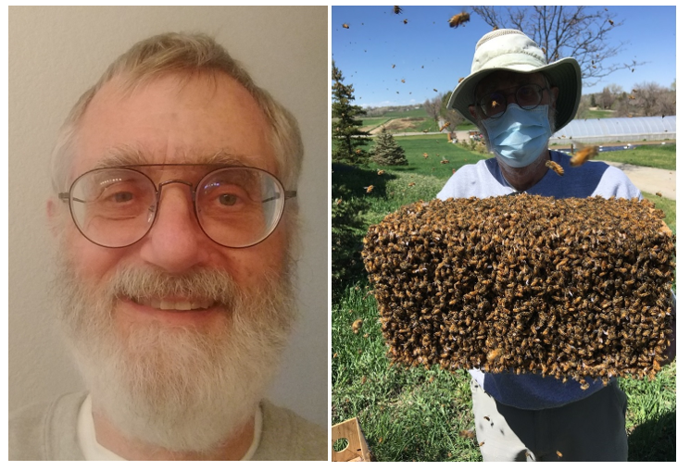
Richard Juday
Longmont, Colorado.
Newlywed (November 2000).
Beekeeper, woodworker, old car restorer, hiker, kayaker, badminton player, SCUBA diver, grandfather.
Recent Oughtred Society member (December 2019). Oldest rule: the Dietzgen N1725 that my folks bought for me in 1957. Another prized possession: the 7-foot Pickett demonstration rule that belonged to Aaron Lerner.
Looking for: Pickett Model 17; it’s of professional interest, since I managed a radiometric flight instrument (S191) on Skylab.
Retired from NASA’s Johnson Space Center after 35 years. Technical areas: radiation hazard to manned flight, remote sensing of earth resources, quantitative use of color metrics in image display, holographic and digital image processing.

Slide 34
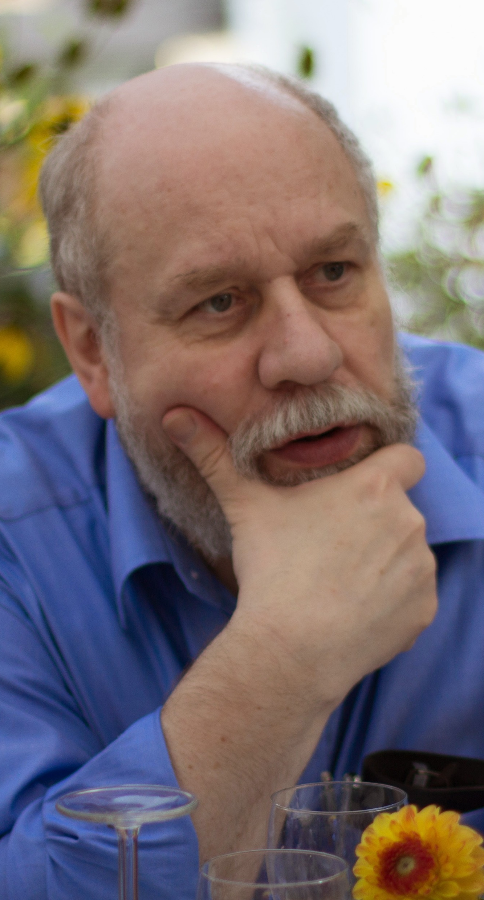
Karl Kleine Jena, Germany karl.kleine@eah-jena.de
retired professor for computer science
organizer / convenor of RST, the group of German speaking slide rule collectors, and IMs in Germany (2013, 2017, 2023)
personal interests
history of computing, especially slide rules, and the interactions of mathematics, engineering and science in history
research based on original sources, patents for slide rules / math. instruments
perception and presentation of computing, mathematics, engineering and science

Slide 38
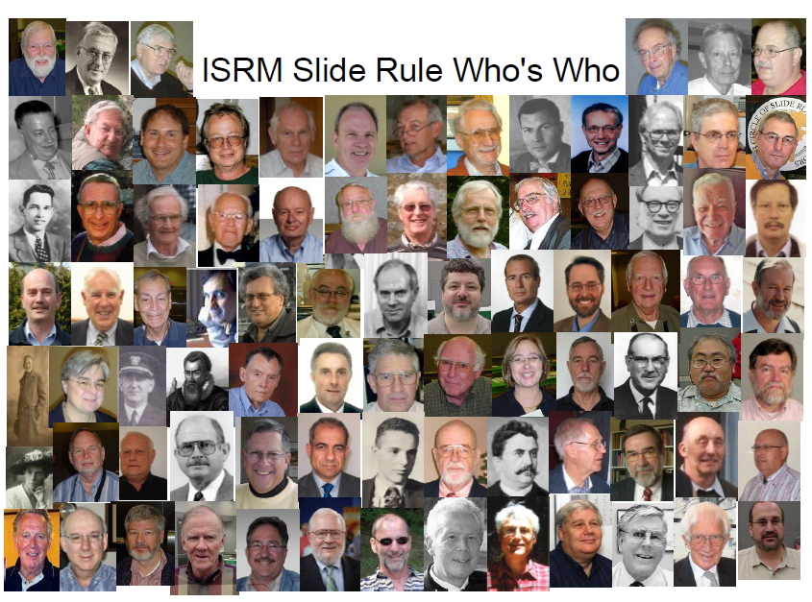

Slide 39
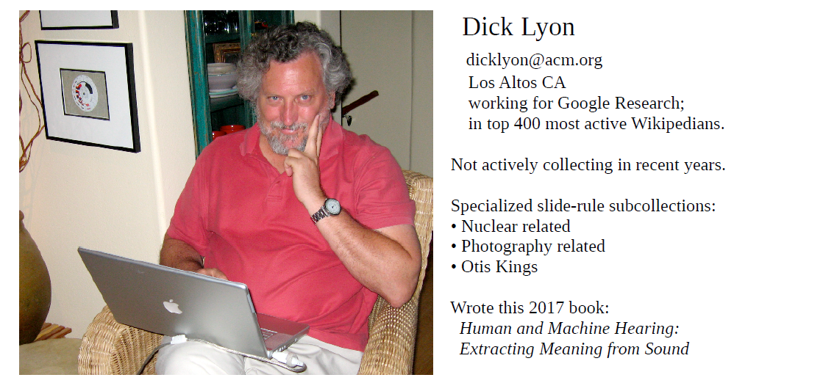

Slide 40
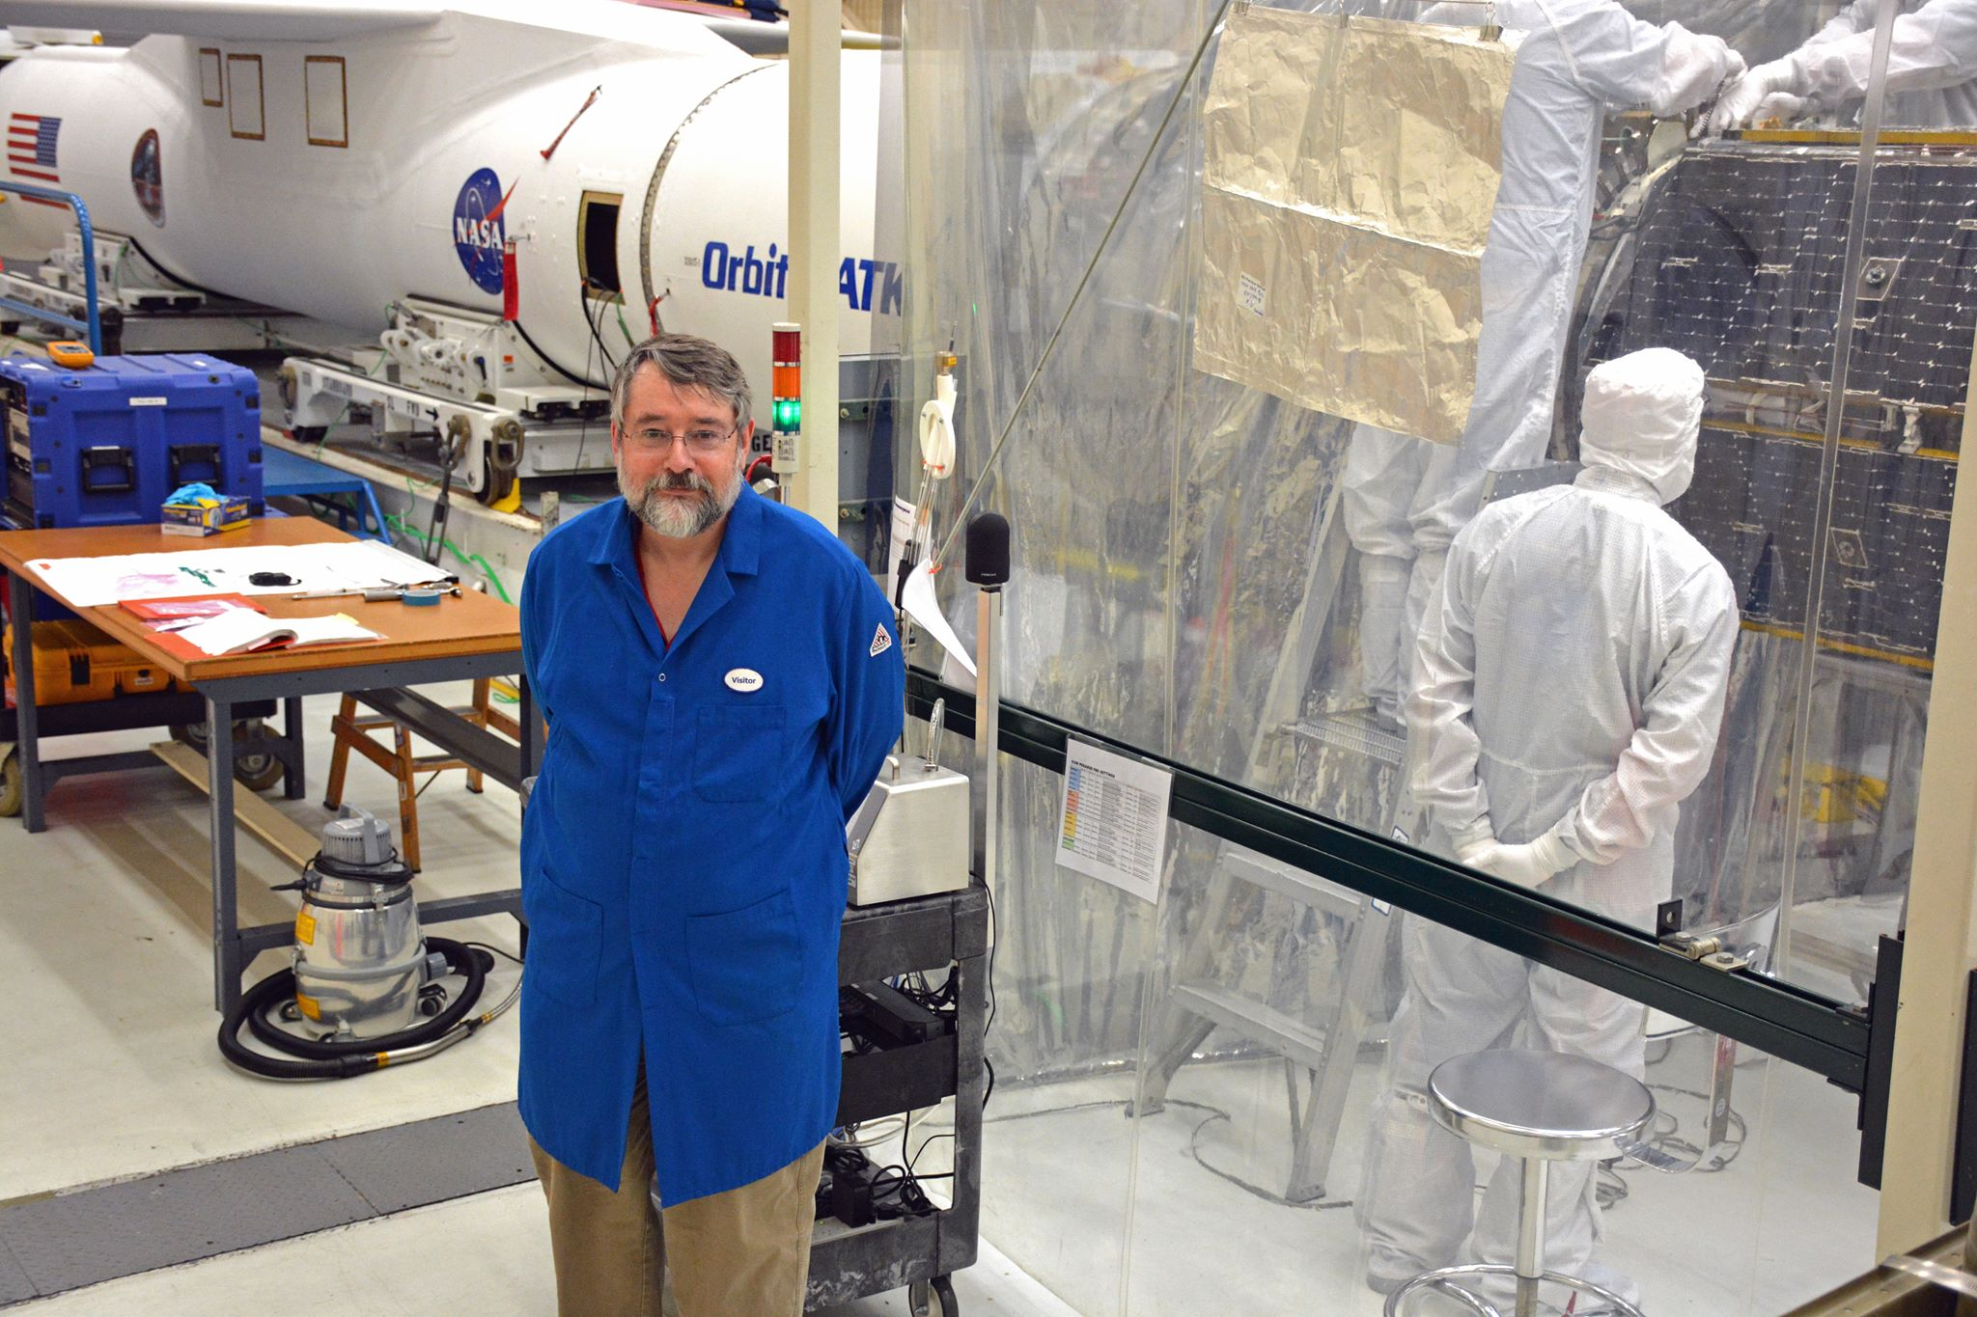
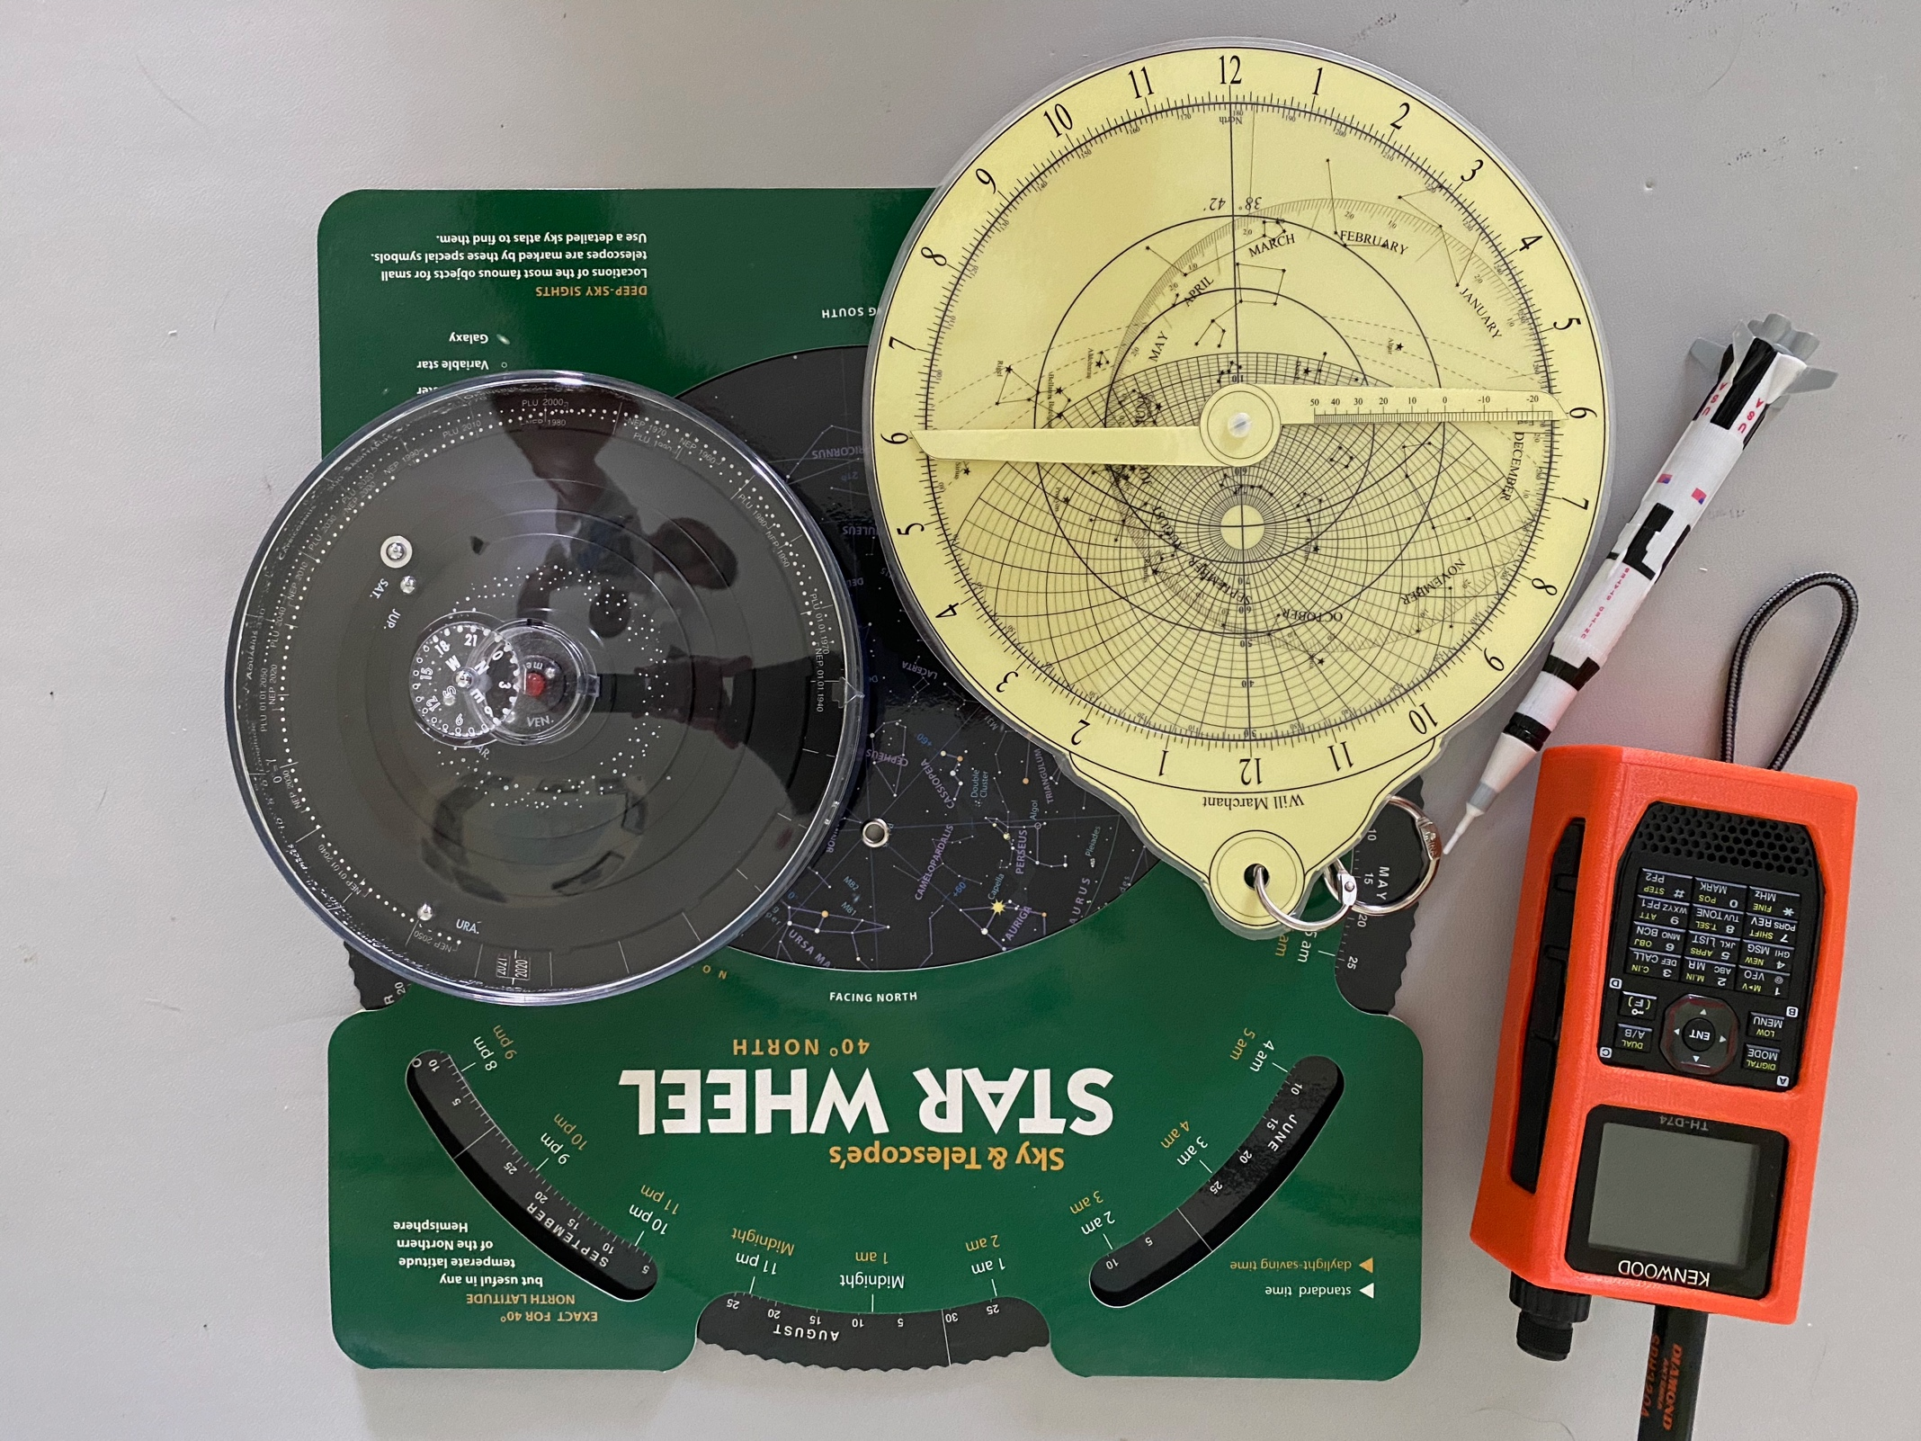
Will Marchant
will@spaceflightsoftware.com
Amateur Radio, Astronomy, Model Rocketry
Aerospace Engineer
Space Sciences Laboratory
University of California, Berkeley
https://www.ssl.berkeley.edu/~marchant

Slide 41
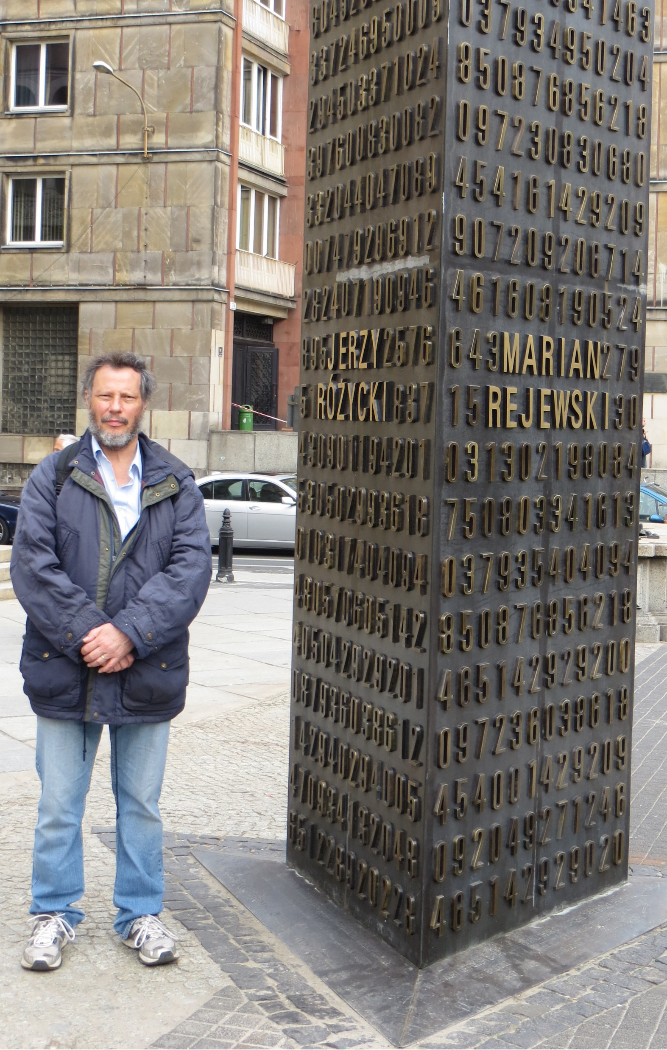
Jerry McCarthy
Jerry’s day job used to be to write software, in areas such as retail systems, cryptography and internationalisation, for a global computing company. Since his retirement, he now volunteers at The National Museum of Computing (TNMOC), which is situated within the Bletchley Park Campus. There, he talks to visitors about, inter alia, Tunny, Colossus, and the Museum’s slide rule collection.
He also volunteers at the Instytut Józefa Piłsudskiego, where he gives the occasional talk on matters cryptological, such as Enigma and early Polish systems for breaking it.
Jerry is not rich enough to be a full-time cryptocollector, but is interested in crypto simulation techniques which allow virtual acquisition of crypto hardware without needing to find the space to store it. Jerry’s house is definitely not big enough for a Colossus!

Slide 42
Paul McConnell

Slide 43
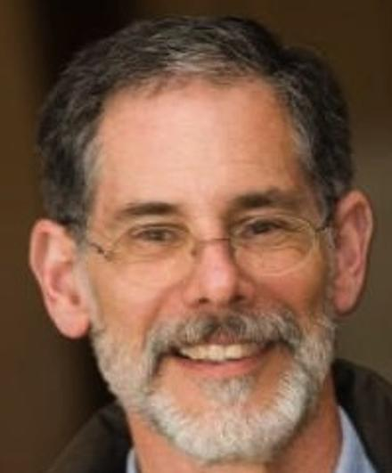
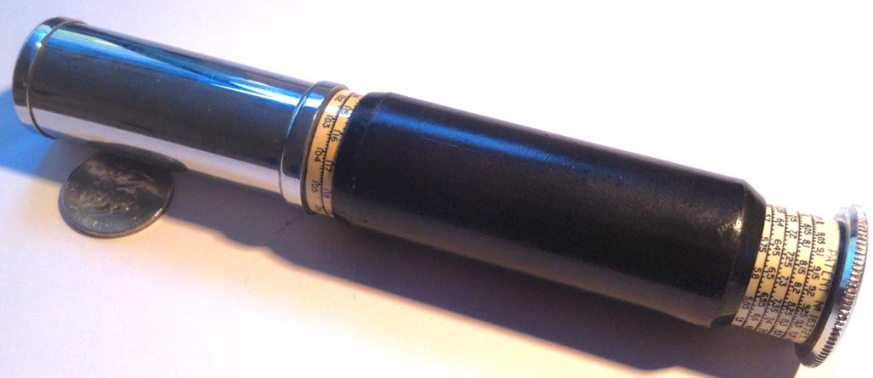
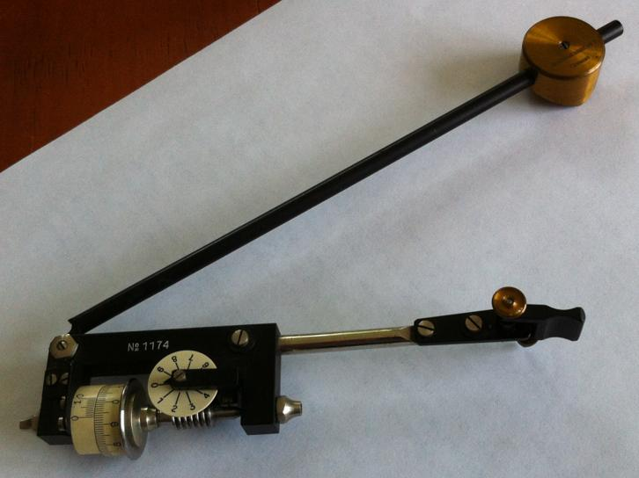
Jon Millen
Rockport, MA
MITRE 1969-*-2012
SRI-CSL 1997-2004
http://www.jonmillen.com/CurtaGL/

Slide 44
Wayne R. Pinnow

Slide 45
John Runnels
Baton Rouge, Louisiana (USA)
Slide Rules: Gilson, Aristo, Faber-Castell
Dogs: Golden Retrievers Obedience, Agility, Tracking

Slide 47
John Terrey

Slide 48
Simon A. M. van der Salm (1953)
Netherlands, EU.
Profession:
Electronics engineer and mathematician.
Lecturer of Mathematical Statistics, College for Biomedical Technologists
Main interests: Statistical slide rules and history of calculating instruments.
Collection: Small collection of Pickett slide rules. Small collection of European slide rules for electronics and radio technics.

Slide 49
Michael J. Vinarcik
Systems Engineer (Model-Based Systems Engineering)
Adjunct Professor (University of Detroit Mercy and CIDESI)
Active in professional societies (founded Sigma Theta Mu, systems honor society)
History of technology enthusiast
Ancient Technology (Antikythera Mechanism)
Rigid Airships
Precision Manufacturing
Novice slide rule collector (Post, K&E, Pickett, Faber-Castell)
Most prized item: Curta Type II

Slide 50
Nathan J. Vinarcik
Eagle Scout w/six palms, Brotherhood Order of the Arrow
First Michigan Boy Scout to receive Edison SuperNova award (highest STEM award)
Junior in University of Detroit Mercy’s 5-year MSME program
System Modeling Internships:
Jet Propulsion Laboratory
Ford Motor Company
History of technology enthusiast
Novice slide rule collector

Slide 51
JEFF WHITE
I am a retired – and still getting used to it – civil engineer, rangeland scientist, and rancher living in Teton Valley Idaho.
My dad, a high school biology teacher, taught me to use a slide rule when I was in sixth grade and I subsequently helped him calculate test scores for his students. At the time, I did not really appreciate the capabilities and sophistication of slide rules; that began when I more fully developed my calculating skills with my Post Versalog issued to me as a cadet at the US Air Force Academy in 1974.
After transitioning from slide rule to calculator – the then mighty HP-45 – I caught a glimpse of the future and began collecting slide rules. Over the ensuing decades I have accumulated nearly 750 slide rules – with no particular
emphasis other than the beauty, elegance, and timeless utility of the tool.
I have been a member of Oughtred since 2000 (and a couple scattered years before
that) and appreciate the commitment of the society's members and those of related
organizations to perpetuate the knowledge, history, and tradition of the slide rule.

Slide 52
Nathan Zeldes Jerusalem, Israel
Physicist ♦ Ex-Intel engineer ♦ Startup advisor
Collecting History of Computing (not just slide rules)
Interested in trends of technology development over time
http://bit.ly/NZ-Hobbies

Slide 54
A heart felt Thanks to all of the attendees who have joined us today and helped make our experiment a success !!
September 12 – 13, 2020 VIRTUAL IM2020 “HELD WORLDWIDE FROM THE SAFETY OF HOME”

